Slide 1
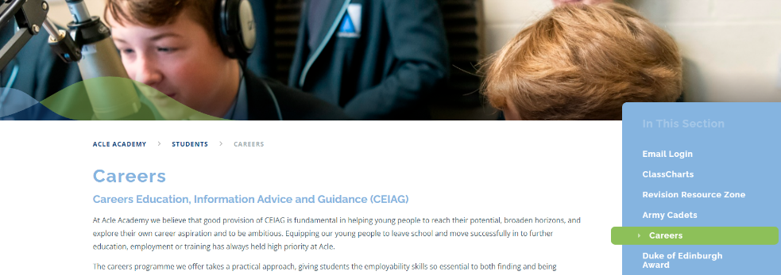
Careers Work Experience and Post 16 Options.
Year 10 -Work experience
Week commencing the 12th June
Norfolk Skills and Careers Festival. W8-9th March 2023; Careers Fair – an opportunity to talk to different education/training/employment providers.
Year 11 Post 16 Applications
Careers Drop Down Day 14th October (Workshops/ mock interviews/ careers fair)
Help you Choose- Login and registration in CC lessons over next 2 weeks.
Independent Careers Advisors Appointment

Slide 2
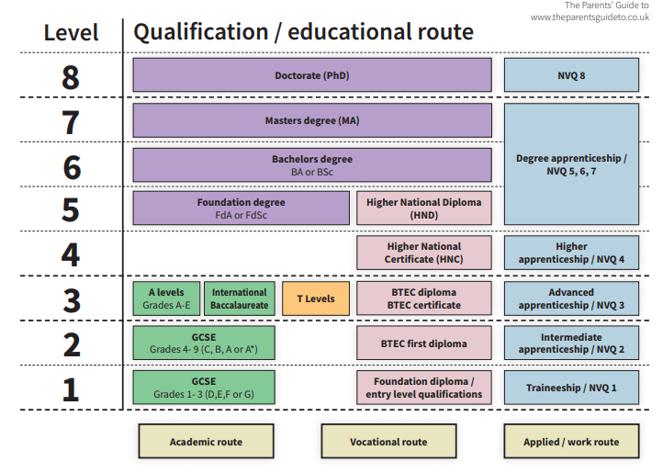
Post 16 Routes
Continue education at Sixth Form or College (A-levels/ Btech)
Learn and earn at the same time through an Apprenticeship
Employment with Accredited Training.

Slide 3
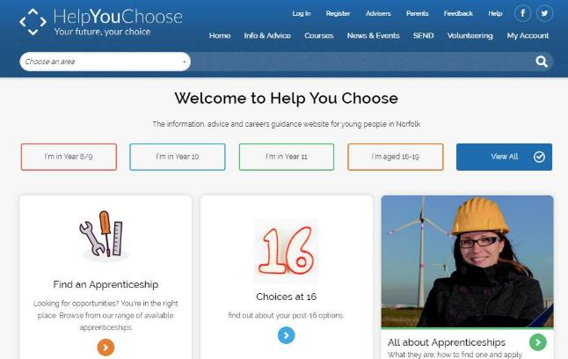
Help You Choose
Why Apply Online via Help You Choose?
All the learning options are all in one place.
Young people can apply to multiple providers using the same information.
They will receive emails to keep them up-to-date with the progress of their applications.
You can find lots of useful information to help support your child in the parents section of Help You Choose
What Happens After Applying?
The student gets an Email Receipt to confirm their application’s been sent
They’ll then get an Email acknowledgement from each sixth form and college when they start processing the application
Some sixth forms and colleges then contact the student to arrange an Advice Interview

Slide 4
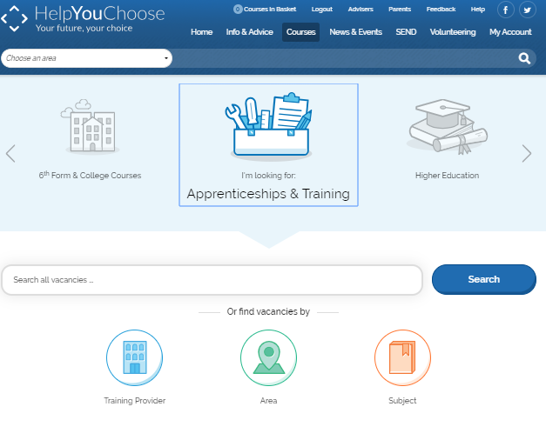
Apprenticeships & Training
If you/your child are interested in an apprenticeship go to the Apprenticeships & Training section on Help You Choose.
Notes:
4

Slide 5
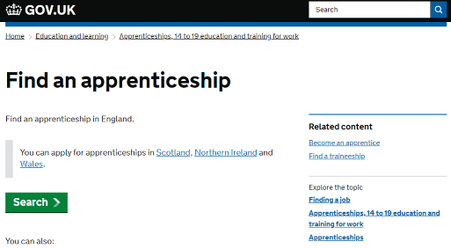
Apprenticeships Norfolk
National apprenticeships website
You can register for apprenticeship vacancies at www.gov.uk/apply-apprenticeship
You can find further information about apprenticeships in Norfolk on the Apprenticeships Norfolk website at: www.apprenticeshipsnorfolk.org
National Apprenticeship week (6-12th February 2023)
Drop down Morning - support with applications
Taster Sessions

Slide 6
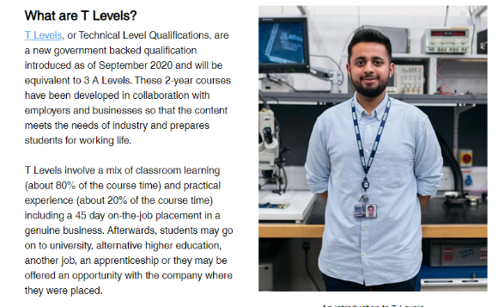

Slide 7
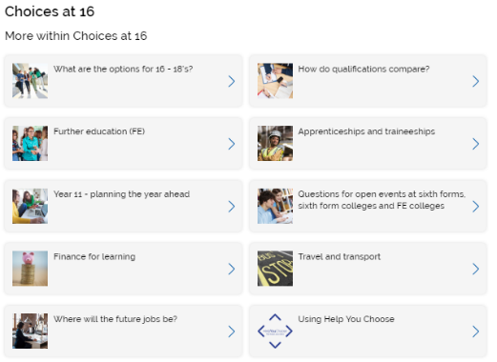
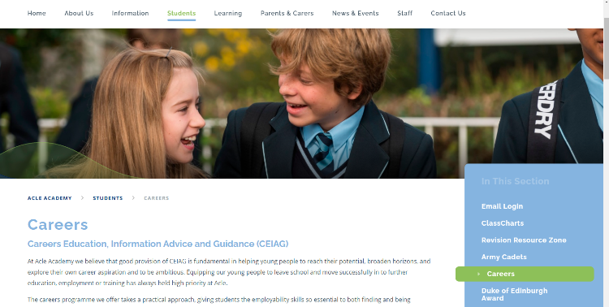
More information… Careers Page on Acle Academy Website Parents Section on Help you Choose

