Slide 1




GCSE Information Evening
This information will also be shared with students in form time and we will continue to communicate with you as we progress in the coming weeks.
If you have any questions following this presentation please feel free to contact me. jsayce@acle.Norfolk.sch.uk

Slide 2
Purpose of the Evening:
Give you key information to help you maximise your child’s potential at GCSE.
To share our high expectations of GCSE students.
To give you an overview of the key subject specific information surrounding your child’s GCSEs.
To update you on any government or exam related changes that affect current students.
Allow you to access all the key information which can support your child at home with their GCSEs.
Answer any questions you might have about your child’s GCSEs.

Slide 3
Following this evening
Speak to members of the Senior Leadership Team, SENDco and HoY.
Watch any section of the event you need further clarification on.
Buy revision guides online via Scopay (if you do not want to purchase them this evening)
Notes:
Mention PP get revision guides for free in point 3- speak to LT privately at the end. Go through how to follow up on the evening- show example video- a few seconds.

Slide 4
Your support network
Mr Sayce and all of LT
Miss John- Head of Year 11
Form tutors
Subject teachers
Heads of subject
Intervention staff
Inspire
Work with us- Teachers aren’t the enemy
Communication is key- if you need specific help or guidance then please speak with us.

Slide 5
Looking ahead-January- Revision Evening…
Focusing more on…
Importance of revision.
How to revise effectively.
Balancing time and stress to cope with the exam workload.
Notes:
Effectivelty tell them that tonight isn’t solely about revision as this will come later in January- with that evening and the break-out sessions

Slide 6
Year 10 key focus message
You don’t need us to tell you how important your GCSEs are.
This is the year where you’ve chosen the subjects you want to do
This is the beginning of your last chapter at school. This is your perfect chance for a fresh start and an opportunity for you to make your own success.
Work hard and you can look back with pride on what you do over the next 2 years.
Picture in your head what you want to happen at the end of the school year in 2024, what results you hope to collect August 2024. Where do you want to be after you leave Acle.

Slide 7
What you need to do in order to succeed with your GCSEs
Effort
We expect students to…
Stay positive
Try your hardest
Respond positively to praise and advice
Ask for extension work if needed
Listen carefully and complete work to the best of your ability
Keep going when things are difficult
Behaviour for learning
We expect students to…
Arrive on time ready to learn
Respect your classroom and equipment
Think before you speak
Raise a hand for questions and answers
Be polite and listen to everyone
Treat others the way you would like to be treated
Home Learning
We expect students to…
Always complete home learning to the best of their ability
Complete home learning tasks on time
Don’t rush this and look for short-cuts, they never work out well.
Notice how I didn’t include ‘being clever’ or anything to do with natural ability…
Working hard and having the right attitude will ensure your success.
Notes:
Discuss progress reports that will come home.

Slide 8
Exams in 2023- Everything you need to know
The Department for Education last week released their plans for Year 11 exams, and we have highlighted the key points below.
In 2021 and 2022, Ofqual made a range of adjustments to the arrangements for NEA and fieldwork and practical science requirements in some GCSEs. The usual arrangements for NEA, fieldwork and practical science are now in place.
For the 2022 cohort, the Department for Education determined that there should be a choice of topics in GCSE English literature, history and ancient history and a choice of content in GCSE geography as part of a range of adaptations to GCSE, for this year. For 2023, the Department for Education confirms the return to full subject content coverage for those GCSE subjects.
For other qualifications, including vocational and technical qualifications taught alongside or instead of GCSEs, a range of adaptations were permitted in academic year 2021 to 2022. Given that public health restrictions are no longer in place, these adaptations are no longer necessary for the academic year 2022 to 2023 onwards.

Slide 9
Exams in 2023- Everything you need to know
The Department for Education last week released their plans for Year 11 exams, and we have highlighted the key points below.
The Department for Education and Ofqual will continue to monitor the path and impact of the pandemic and evaluate the delivery of arrangements this year, including the provision of exam aids, such as formulae sheets, and advance information to support students’ revision, before finalising 2023 arrangements. Our intention is to return to the carefully designed and well-established pre-pandemic assessment arrangements as quickly as possible, given they are the best and fairest way of assessing what students know and can do.
For GCSEs, AS and A levels, Ofqual will, as planned, consider the approach to grading for 2023 in light of outcomes in 2022. Ofqual will also ask exam boards to look carefully at the design of the exam timetable for next year in the light of experience this year, to see if the increased spacing between subjects in the exam timetable should be retained.

Slide 10

GCSE update-Changes announced today! (29/09/2022)
‘This summer was an important step back towards normality. Our plans for 2023 take us a step further, whilst also recognising the impact of Covid.’- DfE
To protect students against the disruption of recent yeats,senior examiners will use the grades achieved by previous cohorts of pupils, along with prior attainment data, to inform their decisions about where to set grade boundaries.
The government is also confirming that students should continue to be provided with support in GCSE mathematics, physics and combined science with formulae and equation sheets, but not with advance information of exam content, as was the case last year.

Slide 11
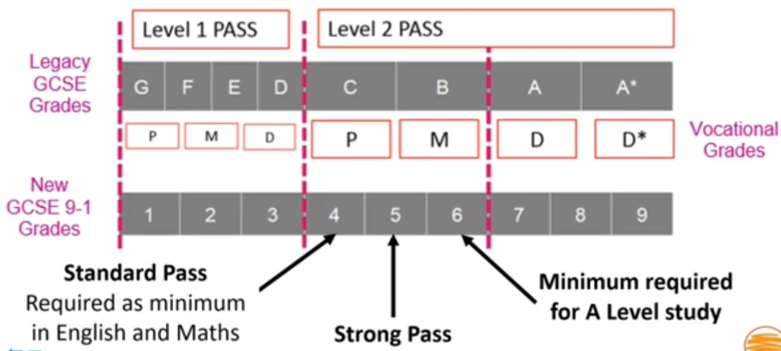
GCSE grades explained

Slide 12
Access Arrangements:
Some students may need access arrangements for their GCSE exams.
Possible access arrangements are as follows:
Reader, Scribe, 25% extra time, use of overlay, use of laptop, prompter, smaller room
If your child has an EHCP then they will automatically be granted access arrangements depending on their needs.
If your child does not have an EHCP then we can either test them to see if they qualify for extra support or if they have a medical condition, then medical evidence can be submitted as evidence to support the access arrangement/s.
We have already sent out letters about confirmed Access Arrangements but if you have any questions or queries, please contact Miss Frary: Lfrary@acle.Norfolk.sch.uk

Slide 13
Structure of the year- key dates
Mock exams- from Monday 28th Nov in hall- lasting 2 weeks- 9th Dec 2022
Year 11- tracking 1- Monday 28th November 2022- reports to follow shortly after this
Year 11 mock results morning- Monday 9th January 2023
Year 11 parents evening- Thursday 12th January 2023
Exam boards release final info on exam content- Feb 2023
Mock exams 2- Monday 20th February- Friday 3rd March 2023
Summer exam series- May-June 2022
Leaver’s assembly- end of June 2022
Year 11 Prom- Friday 7th July
GCSE Results Day- Thursday 24th August 2022

Slide 14





Year 11 Roadmap 2022-23
September
Assemblies on sixth form/apprenticeships
Individual mentoring
Careers education
Be amazing
Bespoke After-school revision
Form time sessions- revision techiniques
New homework expectations
Parents’ information evening
October
World Mental Health Day
Sixth Form Open
days/evenings
Progress Meetings
Careers Guidance Interviews
October Half-Term
Target: Ensure you are beginning to develop the right revision habits, get into the routine of revising regularly. Frequently and in small-bursts is the key. Active revision is the aim.
Target: Engage with revision using active methods and use tools such as GCSEPod effectively.
Attend all mock exams in full uniform with full equipment.
November
Stress and Anxiety Workshop
Mock exams: starting 28th November
Study Support Sessions
(with parents/carer)
December
Mock exams finish
6th Form Application Deadline
Celebration
Day
Christmas Holidays
January
GCSE Revision Evening
Parents’ Evening-12th Jan
Start of GCSE practical exams
Target: Successfully embedded revision methods and have developed study habits linked to frequent revision..
February
After-school intervention
Mental Health Assembly
February Half-Term
Mocks begin 20th Feb
End of June
Prom
Thurs 24th Aug
GCSE Results Day
March
Mock exams: Finishing 3rd March
6th Form Offers
GCSE practical examinations continue
June
GCSE exams continue
Leavers’ Day- assembly
Sixth Form Induction
April
Easter Holidays
Revision focus in all lessons
Exam stress workshop
May
Start of GCSE exams
May Half-Term

Slide 15
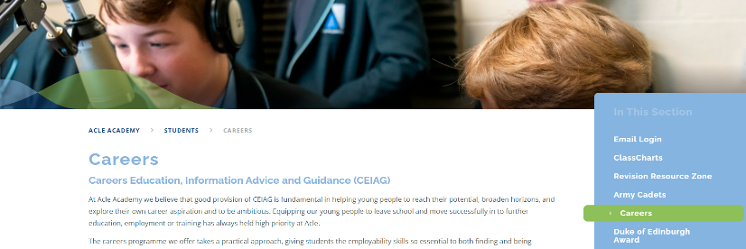
Careers
Work Experience and
Post 16 Options.
Year 10 -Work experience
Week commencing the 12th June
Norfolk Skills and Careers Festival. W8-9th March 2023; Careers Fair – an opportunity to talk to different education/training/employment providers.
Year 11 Post 16 Applications
Careers Drop Down Day 14th October (Workshops/ mock interviews/ careers fair)
Help you Choose- Login and registration in CC lessons over next 2 weeks.
Independent Careers Advisors Appointment

Slide 16
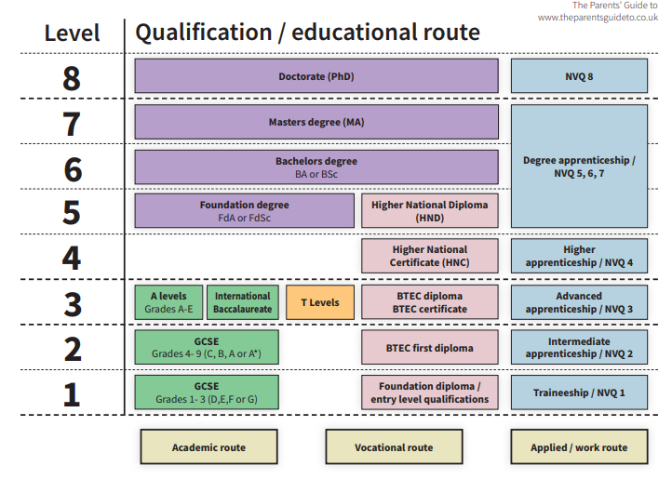
Post 16 Routes
Continue education at Sixth Form or College (A-levels/ Btech)
Learn and earn at the same time through an Apprenticeship
Employment with Accredited Training.

Slide 17
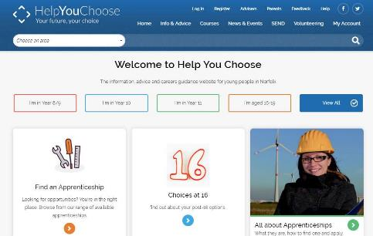
Help You Choose
Why Apply Online via Help You Choose?
All the learning options are all in one place.
Young people can apply to multiple providers using the same information.
They will receive emails to keep them up-to-date with the progress of their applications.
You can find lots of useful information to help support your child in the parents section of Help You Choose
What Happens After Applying?
The student gets an Email Receipt to confirm their application’s been sent
They’ll then get an Email acknowledgement from each sixth form and college when they start processing the application
Some sixth forms and colleges then contact the student to arrange an Advice Interview

Slide 18
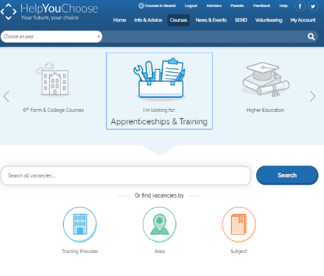
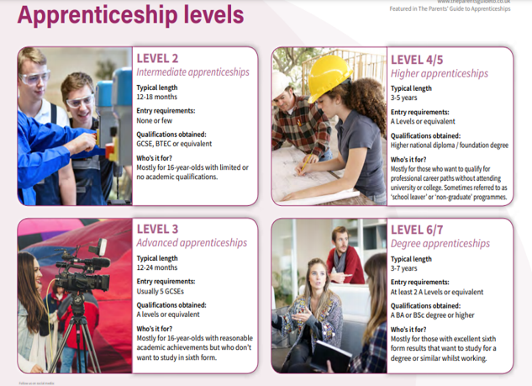
Apprenticeships & Training
If you/your child are interested in an apprenticeship go to the Apprenticeships & Training section on Help You Choose.
Notes:
18

Slide 19
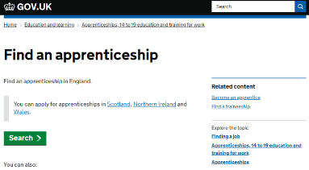

Apprenticeships Norfolk
National apprenticeships website
You can register for apprenticeship vacancies at www.gov.uk/apply-apprenticeship
You can find further information about apprenticeships in Norfolk on the Apprenticeships Norfolk website at: www.apprenticeshipsnorfolk.org
National Apprenticeship week (6-12th February 2023)
Drop down Morning - support with applications
Taster Sessions

Slide 20
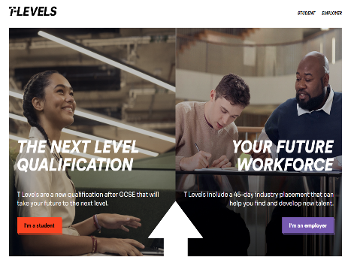
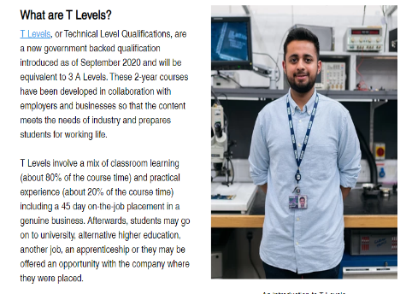
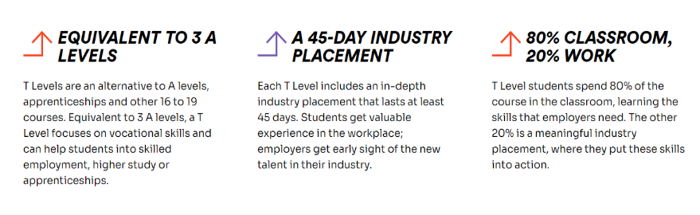

Slide 21
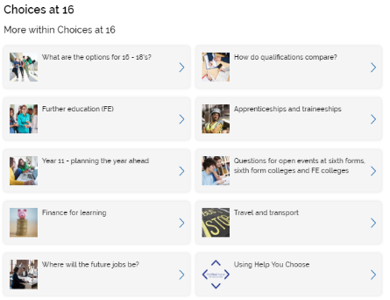
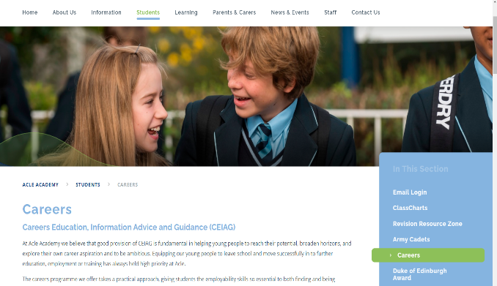
More information…
Careers Page on Acle Academy Website
Parents Section on Help you Choose

Slide 22
The mock exams…
The purpose of the mock exams are to:
Experience a realistic, extended exam programme.
Develop and embed revision techniques and organisational skills. Find what works for you!
Sit exams in the exact conditions the final exams will be in, following the correct protocols.
Get into good habits of checking the exam notice board.
Provide us with accurate information and data for intervention and support.
Receive positive news as well as potentially less positive!

Slide 23
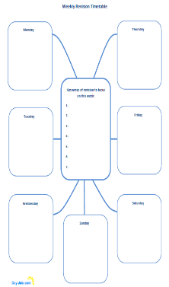
Fail to plan, plan to fail’
Revision timetables
Study planners
Short-term week priority sheet
Little but often Embed the organisational skills necessary to succeed

Slide 24
Is it ever too early to begin revising?
Students who do their best in the GCSE exams, work hard all through Year 10 & 11 rather than relying on last minute revision.
It is best for students to start revision early and to keep revising during the year by doing little but often.
This will give your child time to review what he/she has studied and to strengthen the memory and this will avoid the panic of leaving things to the last minute.

Slide 25






Making use of the resources available to you
We have wealth of incredibly useful and proven revision resources at our disposal to help GCSE students attain highly.
GCSEPod
Acle Academy GCSE Revision Zone
Oak National Academy
Traditional revision materials
Seneca
Pixl Apps

Slide 26
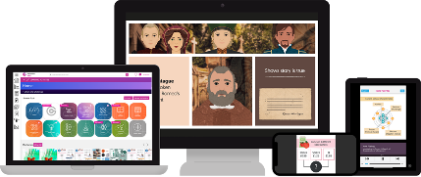
What is GCSEPod?
r Introduction
3-5
minute
‘Pods’
28+
subjects
10 years experience as an award
winning educational publisher
Easy
to use
Mapped to the curriculum
57.9 million pods watched
17.4 million pods watched in 2021
Available on all platforms
1 in 3 secondary schools in the UK subscribe
In use across 40+ countries
“The Netflix of GCSE Content”

Slide 27
GCSEPod covers a broad range of subjects
The subjects are filtered on your child’s account to what they study and their exam boards

Slide 28

Homework
Assessment
Revision
Independent learning
Prep for their next lesson
Teacher Introduction
Examples of how GCSEPod may be used

Slide 29

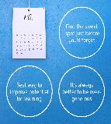
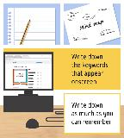
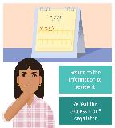
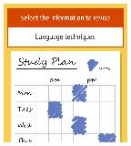
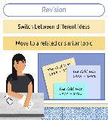
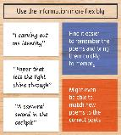
Study smart
The Pods look at the theory behind the science and helps to identify new methods of learning and revision
Study Smart Pods
help you and your child
learn how to learn smarter

Slide 30
Why it works!
Teacher Introduction
Year 11 Impact Analysis
On average, regular users of GCSEPod achieved
On average,
the highest users achieved
Regular users of GCSEPod
achieve, on average
0.7
1
more
Progress 8
points than
non-users
20
Attainment
8 points
more than
non-users
grade
higher per
subject than
non-users

Slide 31
When used effectively, GCSEPod can have a BIG impact on final grades!
In total 14,330 Pods were watched by Year 11 last year and this is an average of 149 per pupil. In total, 21,795 Check and Challenge questions were answered and this is an average of 227 per pupil.
All pupils who watched over 200 Pods had an average P8 score of= +1.17
All pupils who answered 500+ Check and Challenge Questions had an average P8 score of +1.1
Notes:
GCSEPod has a proven effect on final grades. In a recent study on over 3,500 students it was found that on average regular users of GCSEPod achieved 1 grade higher per subject than non-users.

Slide 32
Want to know more?
Teacher Introduction
Visit www.gcsepod.com/parents to find out more and get exclusive access to additional resources that will help you support your child
Register for a free
parent/carers webinars to find out more
Watch the parents introductory video I have uploaded to the school’s website.
www.gcsepod.com/podup-presents-webinars/

Slide 33
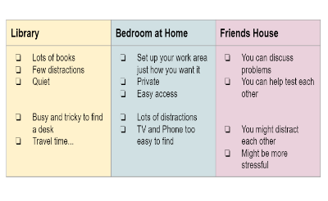
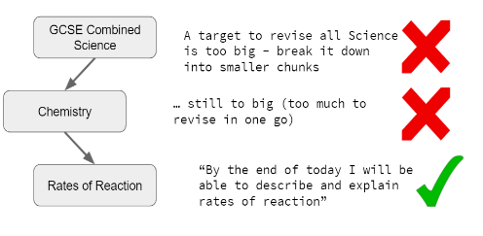
Making a start with revision
1.Motivation- Think about WHY you want to do well in your exams:
Sixth Form
Dream Job
Proving yourself
Focus on YOUR goals and DON'T compare yourself to others!
2. Starting out-
Don't waste time - Just get started!
Turn off your phone (or put it in another room)
Don't listen to music - it is a distraction
Revise in short bursts
Start with something small - ease yourself in
5.Environment-
Think about where it is best to revise for YOU
There are lots of options (look left)
Close the door - shut out noise
Turn your phone OFF
Turn on a light
Get a comfy seat
Get a drink of water or cup of tea!
4. Targets-
Be realistic - make your targets manageable
Make targets for each session, each day, each week, each term
When you hit a target, give yourself a reward
Give enough time to tough topics
3. Make a plan-
It will help you to prioritise
Include ALL your subjects and topics
Identify times when you can revise
Identify when you can't revise too...
Making a Timetable...
6. Rest and relaxation-
Make sure you get some good sleep
Do something relaxing before you go to bed
Take some exercise and get some fresh air
Eat well - lots of fruit and veg!
Drink lots of water

Slide 34




Memory
What do we know about memory?
Your working memory is easily overloaded, cramming doesn’t work
Information is forgotten if not revisited, it’s natural.
Practice and retrieval helps strengthen long term memory & boosts learning

Slide 35
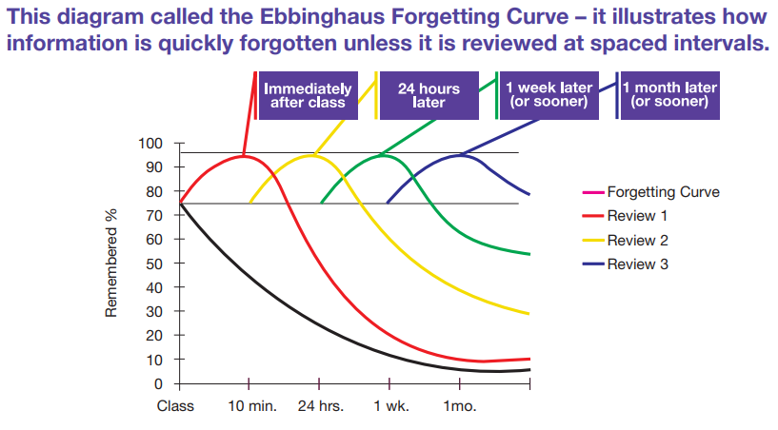
Why is home learning and revision at home so crucial to success?

Slide 36
What can parents do to help to reduce the memory burden?
If homework and revision are left to the last minute, this will limit your child’s chance of doing their best.
Over the next few months:
Ensure that your child attends school and is always on time. Every day lost in attendance reduces their chance of achieving their best at GCSE.
Encourage your son/daughter to persevere and to begin working hard now in preparation for the exams. Check that they are keeping up with homework and attending any and all in- school revision sessions on offer.
Encourage your child to begin revising now at home!

Slide 37
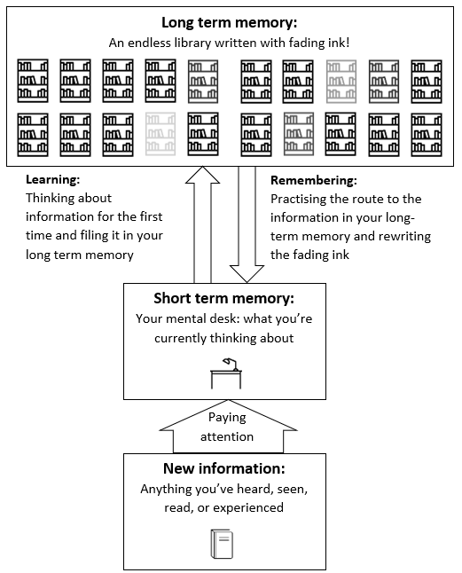

Improve your memory
There are a number of tried and tested techniques for improving memory.
These strategies have been established within cognitive psychology literature and offer a number of ways to improve memory, enhance recall, and increase retention of information.

Slide 38
How much time should they be spending on home learning?
This will vary occasionally as sometimes homework will come in patterns.
On average most studies say that Year 10/11 students should be completing approximately 1 and half hours homework a day.
Getting into good habits linked to completing homework and using time effectively will benefit pupils when revision starts to step up.

Slide 39
A successful student- metaphor
Boxer- the student
Coach- The teacher
Promotor/manager- Parent/carer
"I fear not the man who has practiced 10,000 kicks once, but I fear the man who has practiced one kick 10,000 times”.- Bruce Lee

Slide 40
A successful student- metaphor
Boxer- the student
Coach- The teacher
Promotor/manager- Parent/carer
Parents and teachers cannot sit the exams for you. We cannot make you revise or perform at school. We cannot make every decision for you whilst at school. You are in control of what happens in ‘the ring’/ exam hall.
Any good boxer needs to be prepared for their fight. It is our job to prepare you for your GCSEs, train you with subject content, exam skills and mental agility so that you are ready for the exams.
Boxers need promotors and managers working behind the scenes supporting them. They will provide the morale boosts, offer advice and guidance when needed/ they ensure you are motivated and pick you up mentally when you are struggling. They provide you with all the resources you need to be successful.

Slide 41


Staying motivated
GCSEs are hard and they can become very pressurised.
One of the hardest things to maintain in this situation is motivation.
Without motivation, very little can be achieved.
So, how do you stay motivated when it gets difficult?

Slide 42
KEEPING THE MOTIVATION UP
Students:
Don’t stop working in lessons you find hard or dislike – talk to someone about any difficulties you are having – there is always a solution
Prepare a home learning schedule if necessary and stick to it – even when you don’t feel like it. Don’t wait until you are in the mood – the further behind you get the less you will be in the mood (agree the schedule with your parents for a hassle-free life)
Resist the temptation to bury your head in the sand if things are getting out of hand – talk to your parents/tutor/teachers/Engage/ Mr Sayce
Ignore what friends and others are doing or saying – you are working for an easy life for YOU now and later – let your friends have the hassle of redoing coursework or even their GCSEs

Slide 43
KEEPING THE MOTIVATION UP
Parents:
Agree the balance between work and social life and stick to the agreement. Flexibility is the key – if a special night comes up, agree that they can make up the work at a specified time.
Be flexible – use the 80/20 rule. If your child is sticking to what they are supposed to be doing 80% of the time, they will be doing alright.
If your child asks for your support, encourage them by helping them to see the difficulties in perspective. Teenagers often take an all or nothing ‘catastrophic’ approach to difficulties – “I’ve messed up this essay, I might as well give up.”

Slide 44
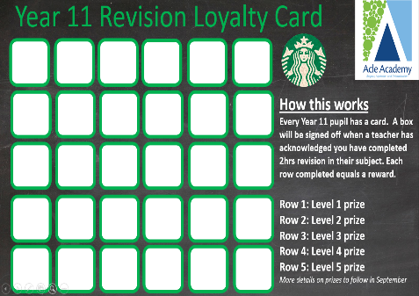
Loyalty card
Their pack had a loyalty card at the front of it.
They are encouraged to earn rewards for additional revision that complete over the summer but also throughout Year 11.
Do expect small but nice rewards.
Don’t expect hugely expensive and spectacular rewards.
Ultimately, this is a little bonus, revision shouldn’t be about rewards but should be about you wanting to achieve.
How the loyalty card works:
For every hour of revision you will show this to your teacher and they will sign it off if they agree the work represents 1hr of exam work.
Once you complete a line you will earn a prize.
Prizes vary and can be claimed from Mr Sayce.

Slide 45

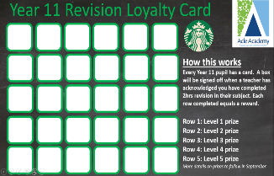
Follow up on this project
Minimum expectation was about 8+ hours over the summer on work.
Pupils need to- Speak to the teacher you did work for and ask them to sign the box on the card confirming how many hours this represented.
Pupils have now had several weeks to get this organised and signed off. Emails and texts have gone home reminding you to follow up on this.
We need parental support to embed this.
Notes:
Give spare copies of the loyalty card to tutors to hand out if the pupils have lost these

Slide 46
Dealing with GCSE stress

Slide 47
GCSE stress- key advice on managing this
Exercise and go outdoors
Easily one of the most frustrating things about exam season is that it seems to occur just as the weather brightens up.
Use this to your advantage and go out for a walk, or a run.
As well as keeping you healthy, exercise is known to boost your mood and can help to make you more productive while revising.

Slide 48

The Power of Sleep
“Research shows that if children are sleep-deprived by just an hour a night, it could reduce their cognitive academic performance by up to two whole years”.
Notes:
ATTENDANCE AND PUNCTUALITY

Slide 49
GCSE stress- key advice on managing this
Don’t (always) listen to others
As the old saying goes: "comparison is the thief of joy". While it is helpful to discuss topics with fellow students and often to revise together, try not to compare other peoples' revision to your own.
Chances are you’re doing just fine, and listening to other people talk about what they’ve learnt will only stress you out. If they themselves are stressed this can rub off on to you and other people’s stress is not what you need right now.

Slide 50
GCSE stress- key advice on managing this
Speak to someone
If the stress gets to a point where it is overwhelming, and is affecting your day-to-day life, try and speak to someone about it.
Speak to your family or us about your concerns, and we will be able to offer more advice on how to manage it.
You won’t be alone in feeling like this and there is help and support.

Slide 51
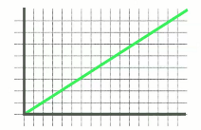

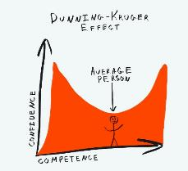
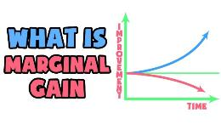

The psychology of success
Progress isn’t linear
Duning-Kruger Effect
Marginal Gains
High impact

Slide 52
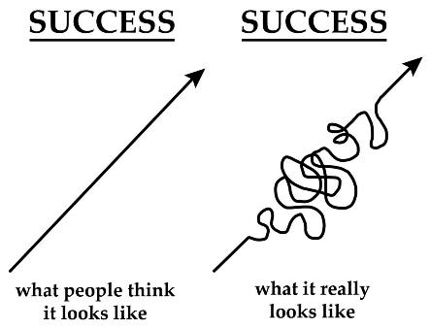
Remember this is based on progress, not ability!
Your progress is not fixed and isn’t always easy.
Your attitude to learning is not pre-determined, you can have a massive impact upon this.
You can all make further progress by working hard at school and trying your best in the lead up to the exams.
It’s within your capability to move up the Progress Ladder if you demonstrate hard work and commitment
It might not always feel like you’re making progress but if you work hard, you will make it eventually. It’s a journey which has its ups and downs!

Slide 53
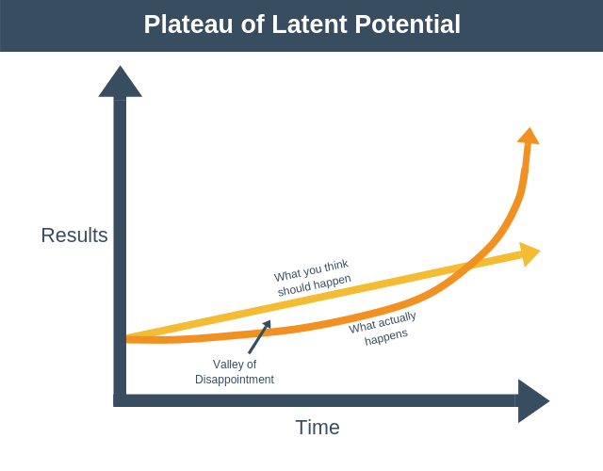
Creating a new habit
You will not see instant results
Notes:
ATTENDANCE AND PUNCTUALITY

Slide 54
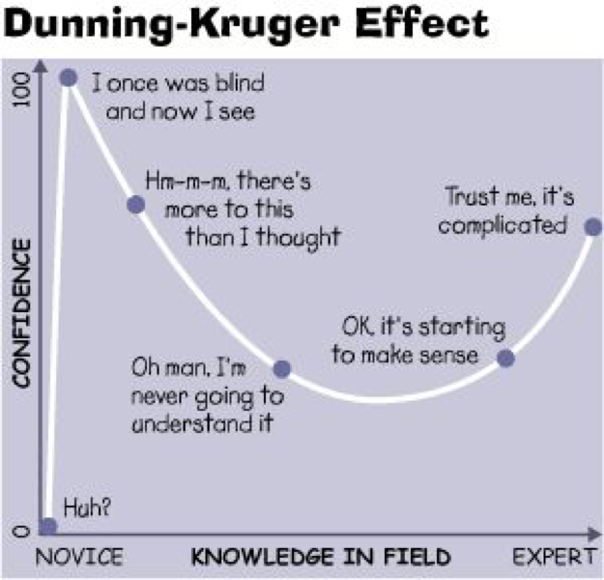
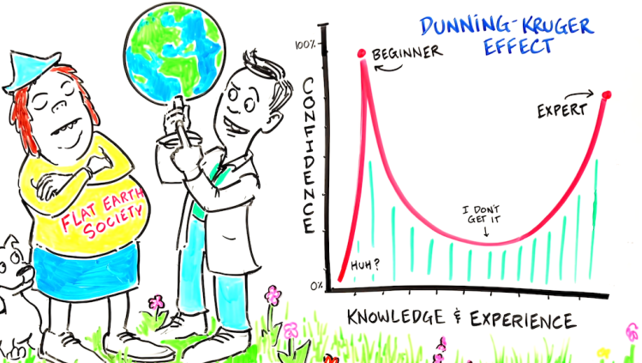
Duning-Kruger effect
Don’t be fooled, it does feel difficult to make progress.
At first, when you don’t work very hard or don’t revise it will feel like you don’t need to, as it will feel like you already know everything you need to know.
However, when you then begin to revise you quickly realise how much there is to know and it is very easy to become overwhelmed and think that you can’t do it or that you’re better off not trying. At this point, you will tend to find that the more you revise or work the less you think you know (as you realise just how much there is to work on).
Despite this, if you continue with the hard-work/revision you will soon see your confidence and knowledge gradually increase and eventually you will see huge progress if you persist.

Slide 55
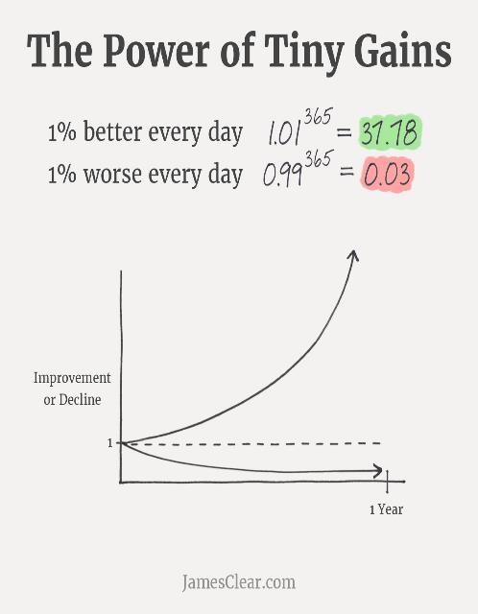
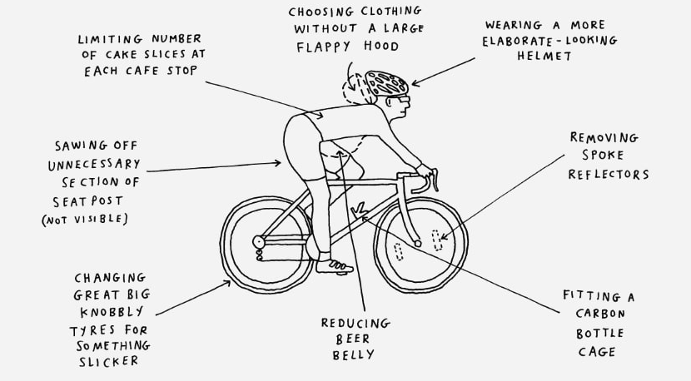
The impact of Marginal Gains
Implementing ideas such as Marginal Gains is another great way to make progress and to do it over a sustained period of time.
Originally designed to help the UK Olympic cycling team and it focused on making small improvements which would each add 1% efficiency at each stage- e.g. changing water filters, washing hands for longer, having specialised pillows. Each little improvement contributed in a very small way to improving the success of the team. Eventually they were the most successful team at the 2012 Olympics and won 12 medals, including 8 golds.
Improving by 1 percent isn’t particularly notable —sometimes it isn’t even noticeable—but it can be far more meaningful, especially in the long run. The difference a tiny improvement can make over time is astounding. If you can get 1 percent better each day for one year, you’ll end up thirty-seven times better by the time you’re done
This could include small changes, e.g. spending 10 minutes less a day on social media, watching a couple of GCSEPod videos each evening, Going through your lesson notes the day of a lesson, creating a flashcard for each lesson etc.

Slide 56
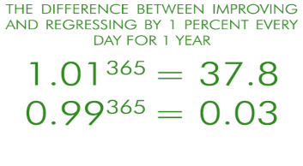
What can you do to get 1% better each day?
Adopt a positive attitude to each and every lesson.
Don’t think of cover lessons as ‘doss’ lessons or lessons where you don’t need to work. That’s on you!
Work out where you are struggling and ask for help.
Consolidate your learning by following on from it- e.g. GCSEPod, Cornell Notes or making flashcards.
Work with your teachers and not against them.
Consider ‘flipped learning’ by looking up topics you’re due to be taught in advance and doing research on them.
Practise exam questions and act on feedback.
Make the most of every minute in lessons.
Stop procrastinating- aim to spend 10 mins less a day on your phone and instead add 10 mins of study time.

Slide 57
Habit forming.
Habits
“Getting one percent better everyday counts for a lot in the long-run”

Slide 58
The Science of Learning
Strategies
Most Powerful Strategies | Least Powerful Strategies
Practice Quizzing Flashcards Mind-maps Spacing out your revision | Re-reading Summarising Highlighting Cramming
These three make you feel you are doing something, but your brain isn’t working hard!
Notes:
ATTENDANCE AND PUNCTUALITY

Slide 59
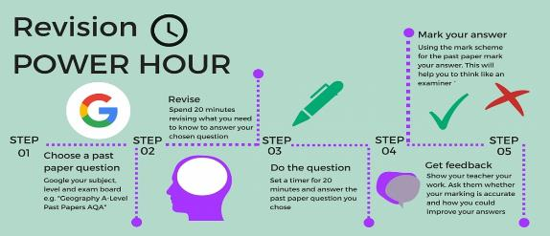
Power Hour technique
‘We were bored with you going on about the Power Hour’
‘It was so repetitive and you were so annoying…’
‘It clearly worked though, so thanks!’

Slide 60
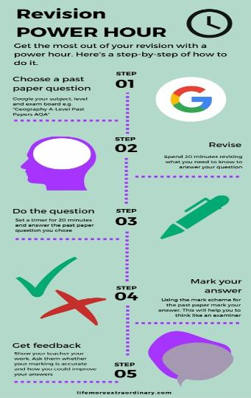
What is the ‘power hour’?
1. Speak to your teachers or use the school revision zone to access all the past papers you could need.
2. Take notes, create a mind-map/ flashcards. You have revision guides and resources provided by teachers.
3. Practising exam questions is hard but it is effective.
4. Again, ask your teacher for a mark scheme or check the revision zone.
5. Hand in your exam answer. You teacher will be happy to check it and provide further feedback.

