Slide 1
Welcome to Heather Avenue Infant School
Information for Families joining us in September 2023

Slide 2
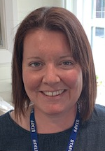
Thank you for choosing our school!
You have chosen a school with outstanding status, we believe we are outstanding because we get to know all of our children well. We work with them and you to ensure that everyone is able to make the best progress, to grow as individuals, feeling safe and happy with our nurturing, professional staff team.
We endeavour to make learning fun and relevant, we ensure that the children feel happy and safe in our care.

Slide 3
In addition:
Over the years we have seen all our children achieve well and make excellent progress from their starting points
We have been awarded English Hub status since 2019
We ensure children are given wonderful opportunities and access to an engaging curriculum which has both breadth and balance

Slide 4
We have achieved many awards demonstrating further our commitment to providing the best possible curriculum experience to all our children.
Our current awards include; International School Award, Arts Mark Gold, History Gold Mark, Geography Bronze Mark, Eco School Award, Gold Sporting Stars Award, Learning Outside the Classroom, Philosophy for Children and Wellbeing Award for schools.

Slide 5
Preparing for Transition to Heather Avenue
To aid your child’s transition to Heather Avenue Infant School, we have our transition timetable of events and plenty of information to share with you today.
We would like all our families and children to feel secure and happy knowing what to expect in September.
If you have any questions please do not hesitate to ask.

Slide 6
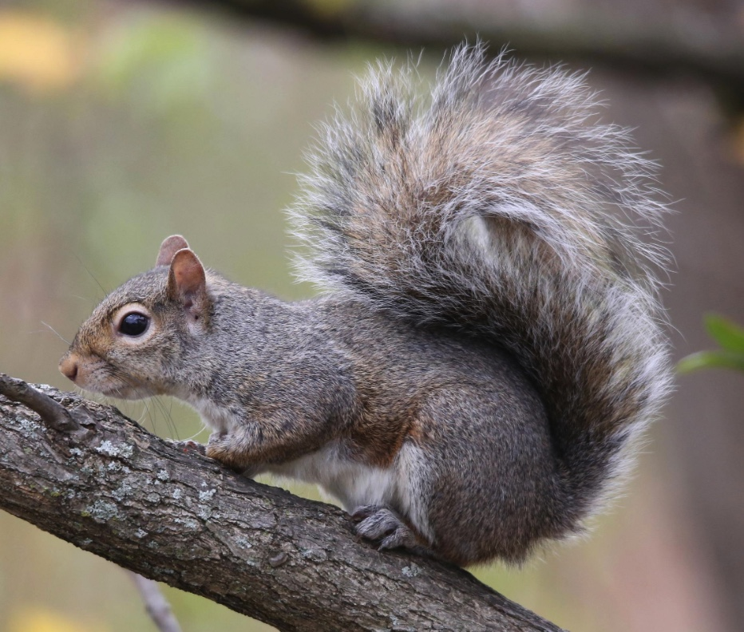
Your Child’s Class
Our Reception staff have created a presentation with information about your child’s new class to share with you.
In September we will have one Reception Class at Heather Avenue Infant School. Your child will be in Squirrels Class.

Slide 7
We are hoping that most of the information you require will be covered today or may be found on our website but please do call or email to ask any questions you have following this event. No question is too small or too silly.
Telephone: 01603 426438 or
Email: head@heatheravenue.norfolk.sch.uk

Slide 8
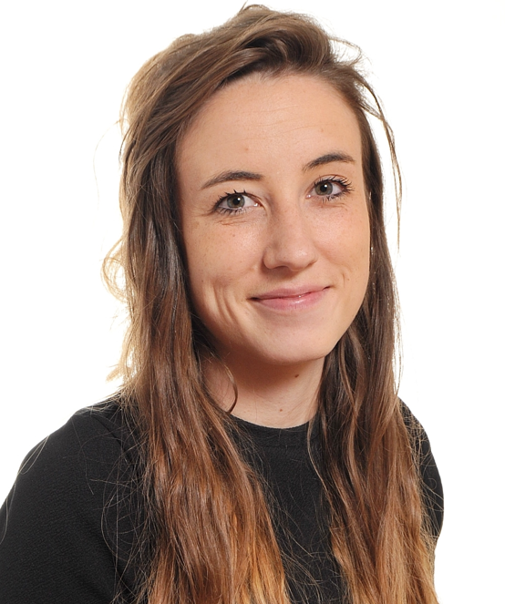
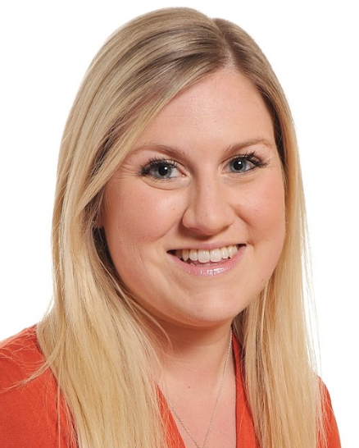
Squirrels Class
Your child’s class teachers
are
Mrs Waters and
Mrs Bailey
Mrs Waters Mrs Bailey

Slide 9
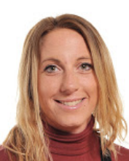
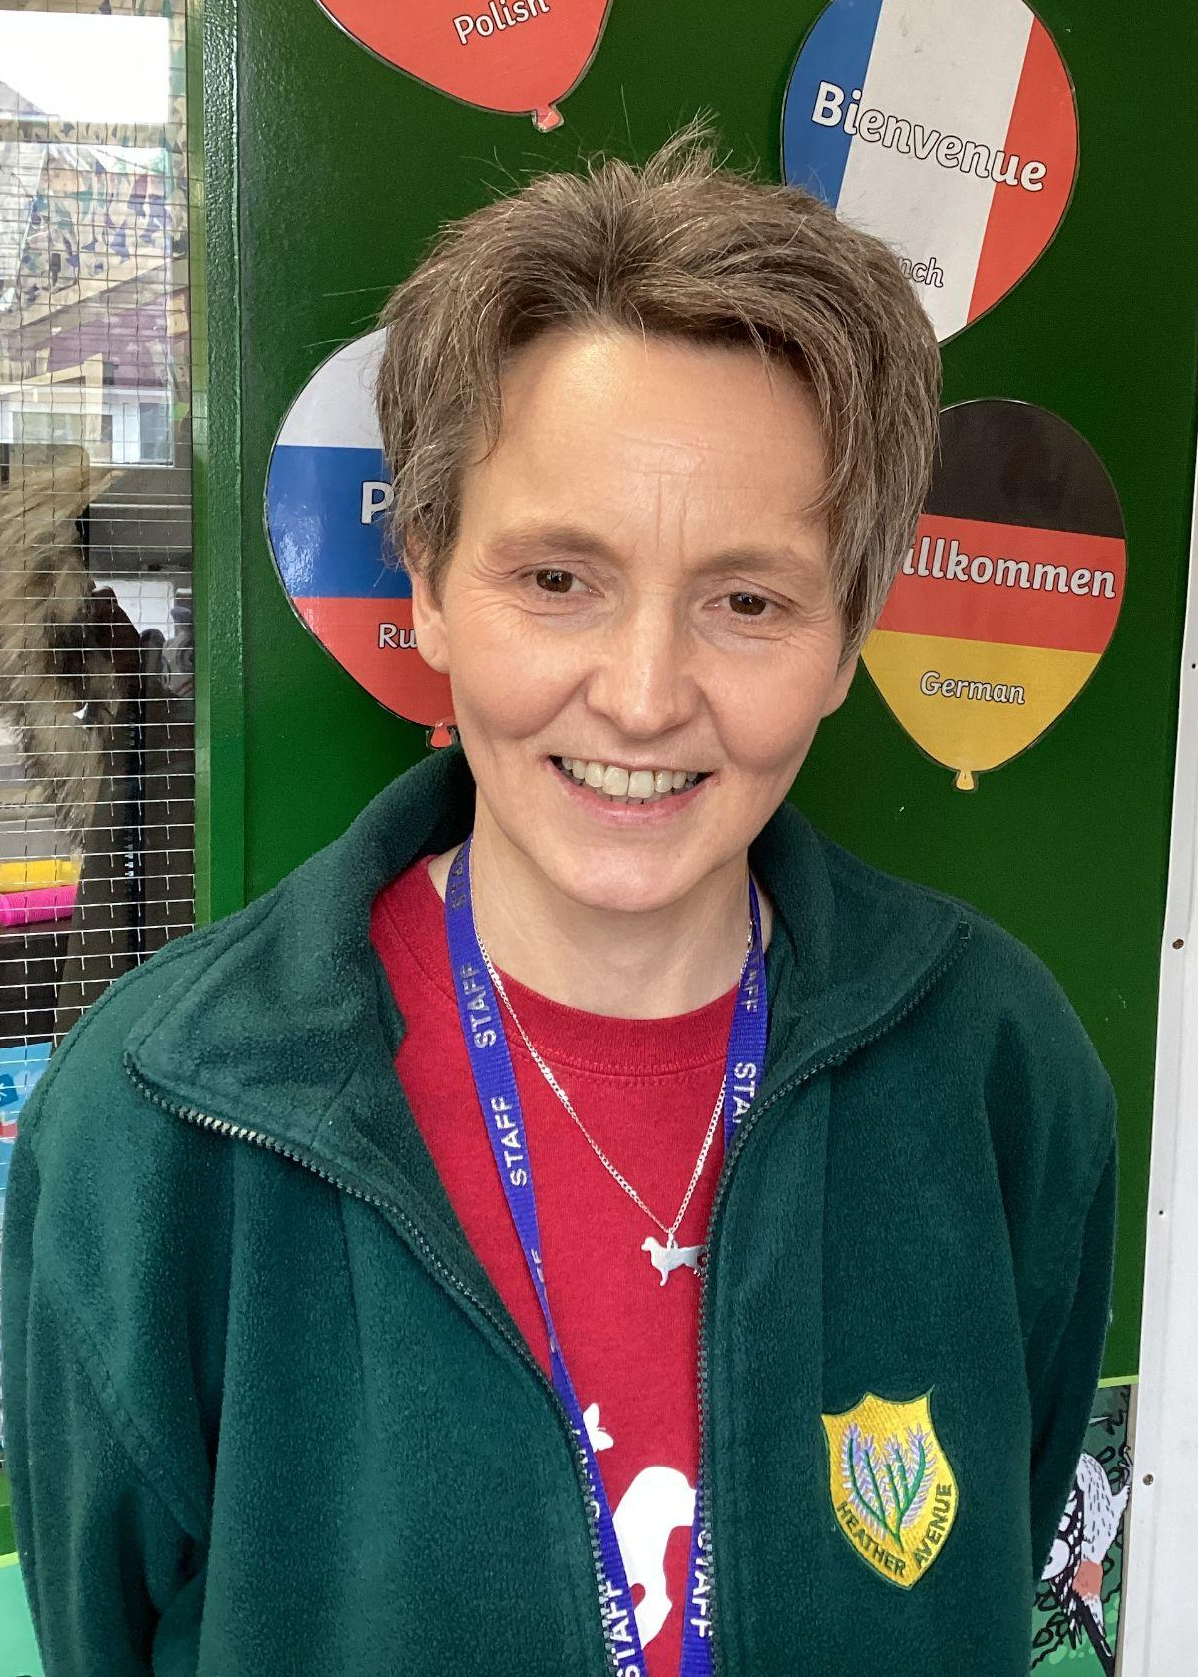
Squirrels Class
The class teaching assistants are
Mrs Felstead Mrs Keeney

Slide 10
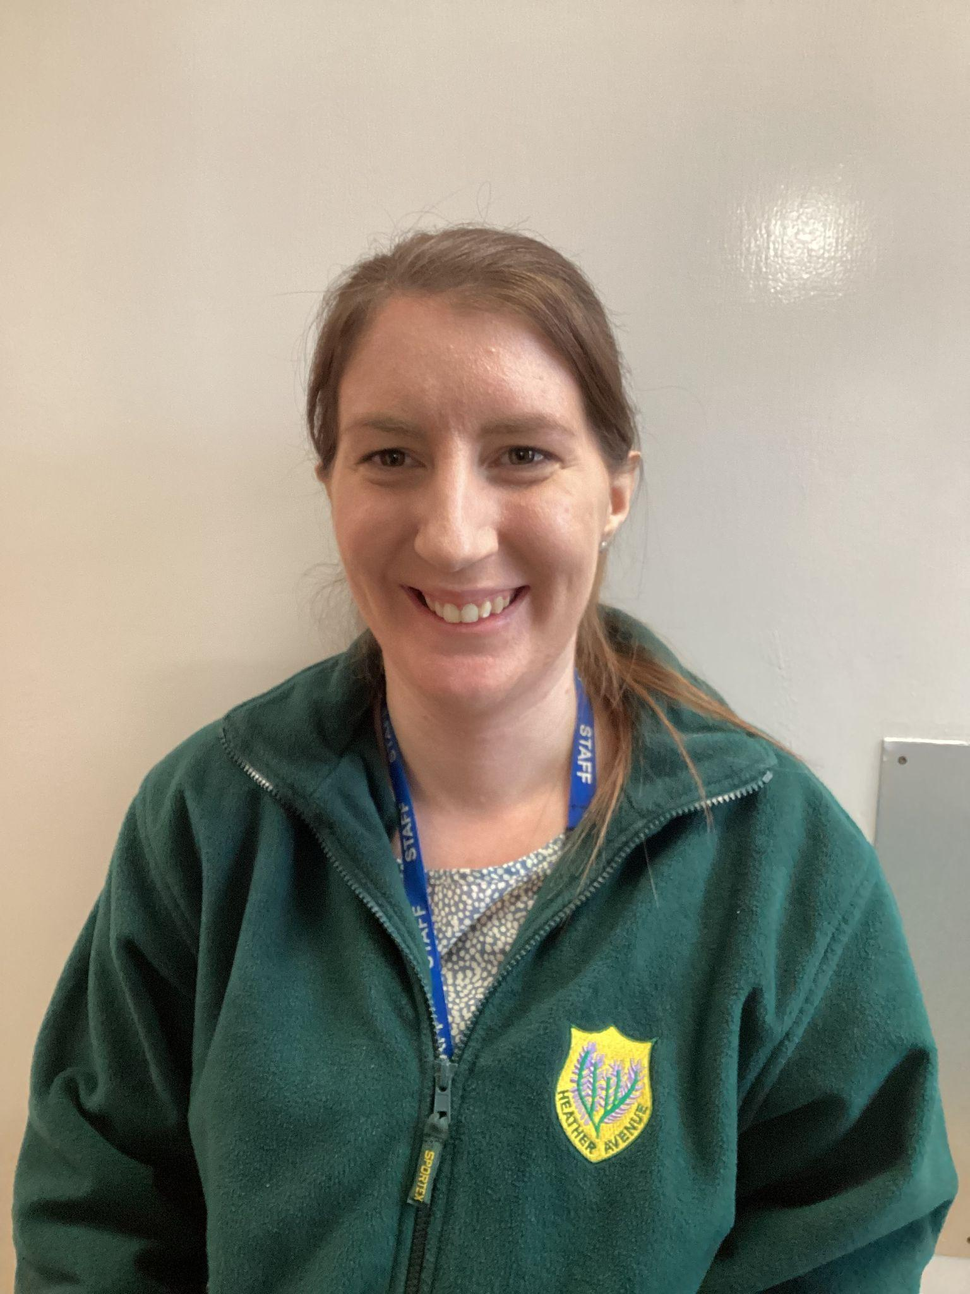
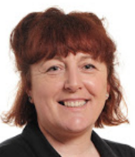
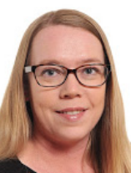
Squirrels Class
The class teaching assistants are
Mrs Farmer Mrs Blyth Miss Allen

Slide 11
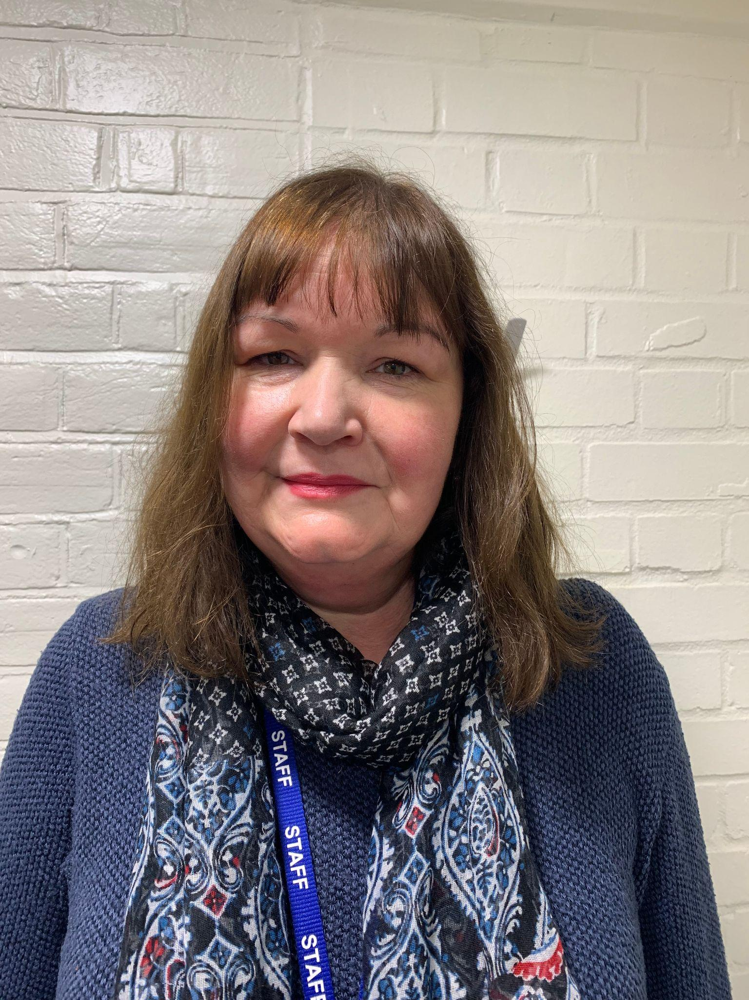
Squirrels Class
The class Cover is
Mrs Bennett

Slide 12
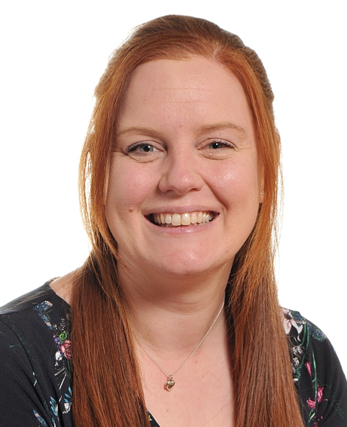
Special Needs Coordinator
Mrs Stevens is our Special Needs Coordinator (SENCO)
She works across the school to support children with their learning and to make sure all children are able to access the curriculum.
If we feel your child requires some additional support with their learning, we will always speak to you first about the things we can do to help and support.
If you want to speak to Mrs Stevens you can call (01603) 426438 or email senco@heatheravenue.norfolk.sch.uk

Slide 13
Intake Forms
You will have received quite a few forms for completion and return, including an admissions form and permission forms linked to various school activities
Please complete and return these to school.
If any key information for your child changes (such as their address) please let us know as quickly as possible.

Slide 14
Our School Day
8.30am: – Soft start: children are able to come into their classes where early morning activities will be available alongside a piece of toast/fruit snack.
8.45am: Registration. All children should be in class.
10.30am: Playtime in the playground followed by a fruit snack and drink in class.
11.45am – 1.00pm: Lunch time – all children are provided with a free school meal by Norse. Children will choose from a hot cooked meal with vegetarian option, jacket potato or school packed lunch each day. Norse will provide you with menus so you can see what the choices are.
3.00pm: End of school day. Children will be collected from their building entrance or escorted to After School Club as appropriate.

Slide 15
Attendance
Term date information is available on our website calendar.
We ask that all children are present in school every day unless they are too unwell to attend, in which case we ask that you inform school prior to the start of the school day. It is important that the children know that school is important and should be attended each day unless they are too unwell. School starts at 8.30 am and children should be in on time each day, ready to start their school day.
The doors for school open at 8.30am, children are welcome to arrive in class from this time. They can come into the class where there will be activities for them to settle to, along with toast and fruit to start the day. All children should be in class by 8:45am each day.
Unfortunately, we are not able to authorise holiday of any description in term time, in line with Government guidance. There is a fine system in place for all schools should a child be absent for 9 unauthorised sessions (4.5 days during a six week period)

Slide 16
Keeping children safe
In school we know that you need to know that we are keeping your child safe at all times. . .
We have a school fob system for all buildings so that no unauthorised adults are able to access the buildings.
All our staff are first aid trained, we ask that any medical or allergy forms are completed prior to your child starting in September for example asthma care plans. This means we can help your child quickly and effectively should they need medical attention.
Our head injury procedure means we will contact you if your child has had a bump to the head, to discuss what happened and how your child is. We also issue emails to you via Meditracker for all accidents and medical incidents so you will know what has happened and what treatment your child has received.

Slide 17
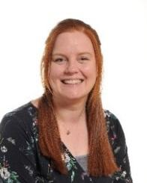
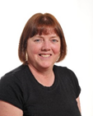
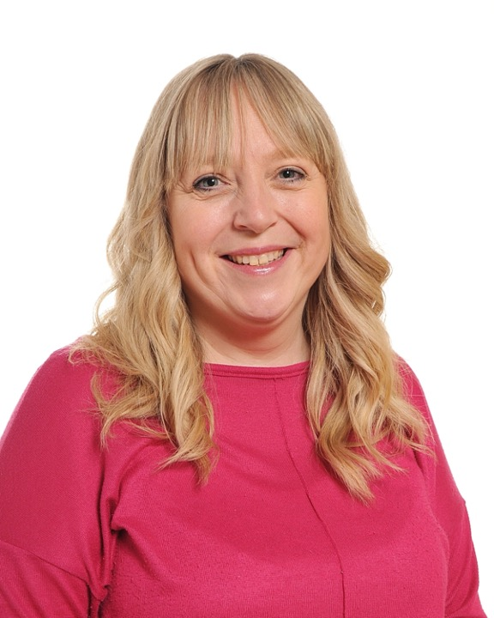
Keeping children safe – Safeguarding
We have 4 fully trained designated Safeguarding leads in school. Ms Coleman, Mrs Stevens, Mrs Howes and Mrs Muff are here should you have any questions or need to report a concern at any time.
Ms Coleman Mrs Stevens Mrs Howes Mrs Muff
Headteacher Senco Teacher Parent Support Advisor
The whole staff team work together to ensure that all children are kept safe. Any concerns are reported, taken seriously and investigated appropriately. We have a robust, secure monitoring system for all children to ensure their safety and well being.

Slide 18
Keeping children safe – Behaviour
To keep all our children safe and happy in school we have Golden Rules for all to follow, children are taught the following rules and what they mean. The rules include;
Do be gentle. Do be kind and helpful. Do work hard.
Do listen to people. Do look after property. Do be honest.
We use positive praise and rewards to support our children in following these Golden Rules. Our restorative approach supports the children in making thoughtful choices for behaviour. We see children’s behaviour as a form of communication and will use the restorative approach to have conversations with children about understanding consequences of their own behaviour. There are regulation stations throughout the school providing time and space for children to calm and reflect.
We ask all parents/carers to support our Positive Behaviour and Emotional Regulation Policy and look to work in partnership with you to support your child.
Children participate in weekly Golden Time sessions for sticking to our Golden Rules. Children children who have been on the class ‘superstar’ three times will be invited to Hot Chocolate Friday with Ms Coleman.

Slide 19
Keeping children safe – Parking
We ask that parents/carers park considerately at the start and end of the school day. Our proximity to local housing can issues with parking at busy time and a walk to school may be far easier than trying to find an appropriate place to park.
You will see that we have a Parking Charter for you to read and agree to. We continually work with our neighbours to build a good relationship and endeavour to ensure that we promote considerate and safe parking to keep our children safe.
We also have a Bike/Walk/Scoot to school initiative for the children to be involved in. Bike and scooter storage is available in the school playground.

Slide 20
Before and After School Provision and Clubs
Breakfast Club starts at 7.30am and runs until the start of the school day when the Breakfast Club supervisors bring the children to their classes. Breakfast Club costs £4.50 per session.
After School Club runs daily from 3.00pm – 5.30pm. Each day is different with a specific activity being held on each day such as craft, cooking, drama or games and puzzles. The cost for this is £6.00 per session.
There are other clubs offered as the year progresses including dance, gym, film, multi-skills, tennis, Rock Steady and piano lessons. Some of these are free whilst others incur a cost - details of clubs will be shared across the school year.

