Slide 1
WELCOME Y13 Information Evening
Wednesday 28th September 2022, 6-7pm
Mr Taylor, Director of Sixth Form

Slide 2
Welcome Back!!
Aims of tonight:
To set clear expectations of what Y13 will require for success
To update Parents/Carers on Post-18 Options
To highlight any upcoming events and/or field questions

Slide 3
What makes a successful Y13 student & getting the most out of the ‘year’
Key Ingredients of ‘success’:
Transition from Y12 to Y13
Responsibility for OWN learning
Independent Learning – Super curricular
Academic Resilience
Knowing when to ask…..
And of course…working hard!!
Getting involved – Student Leadership -Supporting charities
Sport/wellbeing
Being focused on next step……

Slide 4
Key Activities this year
Assessments:
Progress Review timings (Nov, Feb, May)
Pre-Public Examinations (PPE – Jan Y13)
Parents’ Evenings (Dec & March)
Public Examination sessions (TBC- usually June)

Slide 5
Post 18 Options:
Notes:
As you can see here, the main pathways are Higher Education or university, apprenticeships or an internship, taking a gap year or entering employment.

Slide 6
Why higher education?
Watch this video from the University of Sheffield - https://www.sheffield.ac.uk/schools/transition
Opportunities while studying:
Chance to study a subject they are passionate about.
Achieve a qualification that could lead to their chosen career.
Grow in confidence, make lifelong friends, and gain independence and important life skills that will widen their prospects.
With a degree, they’ll have:
the opportunity to follow their career path
better job prospects, as many employers target graduates
higher earning potential
| 6
Notes:
So, let’s start with Higher Education. This is the pathway that about 70% of our students chose to take. Going to university is a great way for students to expand their knowledge, meet new people and enjoy new experiences. It also allows them to develop their self-confidence, independence and responsibility, all important skills for when they do make that move into employment. According to the Institute of Student Employers, university qualifications also lead to better job prospects and the average starting salary for undergraduates is £29,000.

Slide 7
Things to consider…
There are a number of things for an applicant to consider when applying for higher education, such as:
the subject they enjoy – investing time, money and effort
suitable for future career path – have a look on prospects.ac.uk to find out degree career options - https://www.prospects.ac.uk/careersadvice/what-can-i-do-with-my-degree
location – city/rural, transport links
study style – does it suit them?
finances – course fees, travel and living costs
extra-curricular activities/cultural opportunities
| 7
Notes:
Now there are a number of things that students need to think about when applying for Higher Education. Firstly, students should make sure that they select a subject that they enjoy – they will be investing a lot of time and effort into their degree and they want to enjoy it! Students also need to think about where they will be studying. This is a really big decision – a campus university where everything is very close together and all in one place is a very different experience to a city university where students might need to walk 10-15 minutes between locations for lectures. Students might also want to think about the cultural opportunities and the variety of study styles that each university offers, for instance, perhaps the university has its own theatre and puts on a Christmas show, or they offer students additional tutorials throughout the first year to help students settle in. Each university will offer something different and it is important for students to ask as many questions as they can during open days and subject taster events.

Slide 8
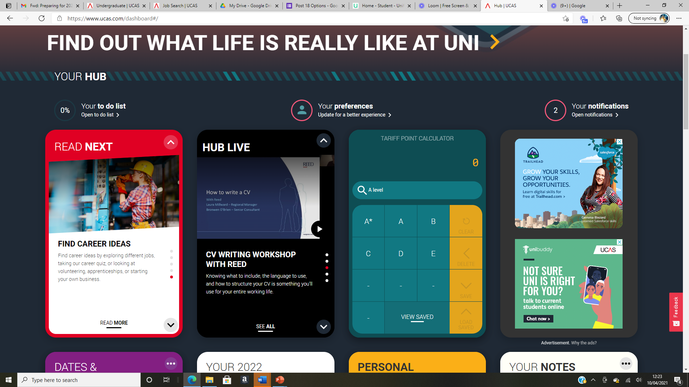
Which university? Which course?
https:// www.unifrog.org
To help you compare university courses, have a look at:
The Complete University Guide (www.thecompleteuniversityguide.co.uk/league-tables/rankings),
Unistats (http://unistats.direct.gov.uk)
The Guardian League Tables (The best UK universities 2021 – rankings | Education | The Guardian)
https://www.ucas.com/students
Notes:
Often it can also be useful for students to compare universality rankings and there are a number of websites students can use to help with this like the Complete University Guide. In school, however, we mostly use UNIFROG and the UCAS website. Students have access to a number of loom videos that go through how to use some of the features available on these websites. UNIFROG is particularly useful for researching different choices, and the UCAS website is the main platform that students will use to actually enter an application. There are also other features on the UCAS website for students to use, such as a tariff points calculator, and an apprenticeship hub.

Slide 9
How do UCAS points work?
UCAS points are a way of measuring the relative value of all post-16 qualifications in the UK. The UCAS Tariff assigns a numerical score to the possible grades that can be achieved in each type of qualification. The higher the grade you achieve, the higher the number of points.
Notes:
Ok, so I’ve just mentioned tariff points and for those of you who aren’t aware, these are essentially the point-equivalent of students’ grades. Hopefully this graphic goes some way to explain this but essentially, if we look at A-levels at the top here, we can see that a grade B is equivalent to 40 UCAS points or tariff points. Therefore, if a university is asking students for 112 points, they would likely need 2 grade Bs and a grade C to receive a place.

Slide 10
Making an application:
Key information:
Students can add up to 5 choices, unless they’re applying to study medicine, veterinary, medicine/science, dentistry – then it is 4 choices
Students can’t apply to BOTH Oxford and Cambridge
Applying costs £22.50 for 1 choice, or £27 for 5 choices
Personal details
Contact and residency details
Work experience
Education
Nationality details
English language skills
Supporting information
Personal statement
Choices – make up to five
References
Finance and funding
Diversity and inclusion (for students with a UK home address)
Security marking: PUBLIC
28 September 2022
| 10
Notes:
So, now we move on to making the application, and as I have already mentioned, students will do this through UCAS. By now, students should be growing increasingly familiar with UCAS Hub and on Monday I will be sharing with a walk-through guide on how to complete the application. Students will need to complete all of the sections listed in the bullet point list above, apart from the references section which their tutors and I will complete. Most of the sections are very straight forward, and it is only really the personal statement and choices section that students will need to spend more time on. Students have up to 5 choices, and we would strongly encourage them to use all 5. I should add here, that if your son or daughter is applying for an early entry course, they can only make 4 choices.

Slide 11
The personal statement
The only section students have full control over
Students only chance to market themselves individually
The same for all choices
UCAS’ similarity detection service:
every personal statement is run through software to check for plagiarism.
A maximum of 4,000 characters, or 47 lines
A minimum of 1,000 characters
There isn’t a spelling or grammar check
No formatting is allowed
Security marking: PUBLIC
28 September 2022
| 11
Notes:
Now, students have been given quite a bit of support and guidance about completing their personal statement but I thought it would be useful for me just to go over some of the main things that students needs to consider.
Firstly, their personal statement can be no more than 4000 characters of 47 lines in length. In that space, students need to say why they like the course they are applying for – they should be specific here, possible giving an example of something they’ve studied at school that might link back to this subject or they should make a direct reference to a future area of study if it is taught by all 5 of their options. Universities also want to know what personal skills, qualities and experiences students have that will help them succeed at university – the aim here is quality not quantity and students need to ‘show’ their skills not just tell the university about them. For example, if they want to signpost their communication skills, they should talk about a specific occasion where they have demonstrated these skills successfully, perhaps in a part-time job, rather than just saying that they have good communication skills. Every personal statement will usually follow a similar split – 70-80% academic, 20%-30% for the extras, like extra-curricular activities.
The main advice here though is that your son or daughter's personal statement needs to stand out. One way that students can do this is by talking about their work experience. Now obviously, given the current situation, face-to-face opportunities have been limited, however there are a huge number of companies offering virtual work experience, even just for a day, and this would really help an application stand out. At least once a month, an updated list of virtual opportunities is posted on to the Google Classroom, and there is a also a virtual opportunities board just outside the study centre that students have access to. I would strongly encourage students to sign up for some of these opportunities.

Slide 12
The personal statement should:
be 4000 characters or 47 lines of text (including spaces), whichever comes first
show the applicant’s character, knowledge, experience and ambition
You MUST ensure that you answer the following questions within your statement:
Why are you applying for this course/apprenticeship/employment sector?
What do you know about the subject and what aspects particularly interest you?
What personal skills, qualities and experiences will help you in this subject/role and how did you acquire these?
EVERYONE MUST WRITE A PERSONAL STATEMENT.
The personal statement:
THE BASICS
Notes:
Whatever they are choosing to do, we are asking all students to write a personal statement. This is because a lot of apprenticeship providers and companies are now moving away from CVs and short-answer responses in favour of a larger piece of writing. Prospective employers will be looking for exactly the same sorts of skills that university admission teams want to see.
Through tutor time and conference, students have been given quite a bit of support and guidance about completing their personal statement but I thought it would be useful for me just to go over some of the main things that students needs to consider.
Firstly, their personal statement can be no more than 4000 characters of 47 lines in length. In that space, students need to their personal skills, qualities and experiences. Universities and apprenticeship providers want to know why students would be well-suited to studying their chosen university course, or working in their chosen industry or sector.

Slide 13
You need to make your personal statement competitive!
You could include:
details of wider reading with accompanying critical reflection
extra reading – quality vs. quantity
details of work experience for competitive vocational curses with critical reflection
extra-curricular vs. super-curricular activities
don’t summarise the whole subject – it’s ok to focus on something niche.
‘Show, don’t tell’
For example:
‘I am good at communicating with people’ would be better as ‘My interpersonal skills have been developed by working part time in a busy city centre store. I have, occasionally, had to deal with angry and dissatisfied customers and I have been able to defuse situations successfully and to resolve their problems’
Notes:
Students should be as specific as possible and give clear examples. For example, if they want to signpost their communication skills, they should talk about a specific occasion where they have demonstrated these skills successfully, perhaps in a part-time job, rather than just saying that they have good communication skills.

Slide 14
The structure:
Between 70% and 80% of the statement should focus on academic and course-related information
The remaining 20% - 30% could include relevant information on the applicant’s extracurricular activities
Notes:
Every personal statement will usually follow a similar split – 70-80% academic, 20%-30% for the extras, like extra-curricular activities such as playing an instrument or completing the Duke of Edinburgh Award.
The main advice here though is that your son or daughter's personal statement needs to stand out. One way that students can do this is by talking about their work experience. Now obviously, given the current situation, face-to-face opportunities have been limited, however there are a huge number of companies offering virtual work experience, even just for a day, and this would really help an application stand out. Even now at this stage, there may be some opportunities over October half-term – if we are made aware of any, they will be posted onto the Y13 conference classroom.

Slide 15
What should you not include in your personal statement?
The name of a specific university (unless you are referring to outreach activities/summer schools). This is not the case if you are using your statement to apply for an apprenticeship – you would definitely want to say the company name at this point.
Over-exaggeration
Repetition and waffling
List of skills and work experience
A definition of the subject
Jokes
Generalisations and clichés
Don’t start every sentence with ‘I’
Passive comments
Notes:
Now there are some things that students should definitely not include in their statement, for instance, jokes, generalisations and over-exaggeration. If your son/daughter is applying to university, they should also avoid mentioning their chosen university by name. This is not the case if you are using your statement to apply for an apprenticeship – you would definitely want to say the company name at this point.

Slide 16
How do I write a personal statement?
There is lots of advice available about how to write an excellent personal statement:
https://youtu.be/gLokG6bhPCw - University of Birmingham
Writing a Personal Statement – YouTube – University of Bristol
Personal Statements - Top Tips – YouTube – Durham University
https://youtu.be/3nqjek7GkO4 - University of Southampton
https://youtu.be/oDtz3z-w_3M - University of Winchester
Notes:
It is important that students spend some time working on their personal statements. There is a lot of advice available to students and I have listed here a couple of the links that have been shared with students recently that offer a range of top tips.

Slide 17
Key deadlines:
NOW!!1st October 2022 - Oxbridge/Early Entry Applicants must have completed their applications, including their Personal Statement.
25th November 2022 – All other university students must have completed their applications, including their Personal Statement.
AIM: to send all applications off by Christmas
25th January 2023 – Apprenticeship/Employment/Gap Year students must have completed their applications, including their Personal Statement.
Notes:
So, here are the key deadlines for your son/daughter. Applications for all early entry courses and for Oxbridge need to be with UCAS for the 15th October. To ensure that we meet this deadline, we will be asking for all early entry applications to be complete by the start of October. For all other university applications, UCAS has set the date of the 26th January. This is a little bit later than in previous years, however, we would like to submit all applications before the Christmas break. Usually, the Year 13 PPEs take place in January and want students to be able to focus on these without worrying about their applications. So, with this in mind, all applications for those students who want to go to university must be complete by the 26th November. Students who are writing their personal statement in order to apply for employment or an apprenticeship have until the 24th January to complete their statements.

Slide 18
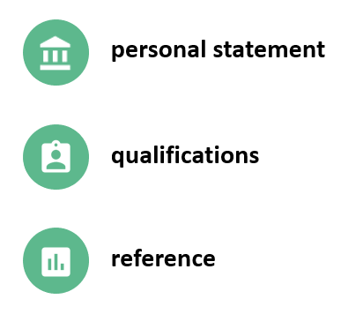
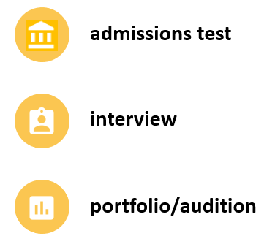
What happens next?
Students should head to ucas.com to track their application.
Once students have decisions from all their choices, they can hold a maximum of two offers:
one as a ‘firm’ acceptance – their first choice
the other as an ‘insurance’ acceptance. This acts as a back-up if they don’t get into their ‘firm’ choice
They must then decline any remaining offers.
Once all decisions and replies have been made, if students aren’t holding an offer, they may be able to use Extra or Clearing to find available places.
Notes:
Once students have completed their sections of the application, they will need to pay £26.50 to UCAS via debit card. I will then read through their application and add in their reference and predicted grades, and it will then be sent off, via UCAS, to their chosen universities.
Some universities will make contact straight away and students may be made offers or invited to interviews, open days, auditions etc. However, some universities are very slow to respond and students must be prepared to wait for quite a long time. All decisions will be shared with students via the UCAS website. Once a student has received all of their offers, they then need to select a firm and insurance choice. Their insurance choice should be a back-up so we would always encourage students to select an insurance choice that asks for lower grades than their firm choice. Students will usually have until the end of April/start of May to make their decision about firm and insurance choices.

Slide 19
Other options:
Extra (Feb – Jul)
Used all five choices and had no offers.
Add Extra choices for consideration one at a time in Track.
Clearing (Jul – Oct)
Apply after 30 June, receive no offers, decline all offers, not met conditions.
Find vacancies from early July, and add a Clearing choice to their application.
Security marking: PUBLIC
28 September 2022
| 19
Notes:
If a student receives no offers and has not used all of their 5 choices, they can add further choices through a system called ‘Extra’. Students should either talk to myself or their tutor if they find themselves in this situation so that we can offer further guidance.
If, by the start of July, students have either not received and offers or declined all of their offers, they will be able to add a clearing choice to their application. We will also be available on results day to help those students who need to use clearing because they have not met the conditions of their original offer.

Slide 20
Student Finance: How much does it cost to go to university?
The cost for university is called a tuition fee.
The current fee for a standard full-time course is £9,250 per year.
You don’t pay tuition fees upfront, instead, you apply for a student loan and this is paid to the university directly by the Student Loans Company.
You apply for your loan through student finance on the government website. Tuition fee loans go directly to your university or college.
Notes:
Now, I know that most of you will have questions about student finance. This is organised through the Student Loans Company and all of the information that you will need is available on their website, although the figures might not be completely accurate as their website is still currently targeting students who will be starting university this September. Despite this, I just wanted to offer a quick run though based on what we currently know. All students will need to pay a tuition fee for the cost of university. The current fee for a standard course in 2021 is £9250. All students are guaranteed to receive the full tuition fee loan, and the money goes directly to their university.

Slide 21
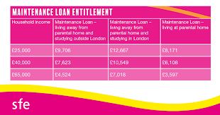
Living costs are different because how much a student is entitled to is based on household income. Therefore, students may need to look at other ways to cover living costs, e.g. getting a part time job, applying for a scholarship etc. You can check how much maintenance loan a student would be eligible for on the government website now: https://www.gov.uk/student-finance-calculator
Notes:
To help towards living costs, students will also need to apply for a maintenance loan. This is means-tested so it is based on household income. This might mean that students don’t receive the full maintenance loan on offer. At the moment the maximum amount students can receive is £9488 if they are living away from home outside of London. This amount is less if students remain living at home. If students are not eligible for the full amount, there are a number of bursary and scholarship options available from each university. Students will need to discuss these options with their university and they will apply for these directly once they have accepted an offer from that university. Again, just to remind you, these figures are for 2021 entry and may change for next year. Students can make an application for student finance in April 2022, and we will support students with this during tutor time and conference.

Slide 22
After university…
https://www.gov.uk/student-finance
https://www.ucas.com/sfe
https://www.moneyadviceservice.org.uk/en/articles/student-finance#how-much-does-university-or-college-cost
Students only start paying it back in the April after they've graduated, and only when they start earning over a certain level of income. The threshold is currently £27, 295 (this is expected to go up each year).
Interest is applied to your loan at RPI plus 3% per year but you will still pay the same amount back each month – it’ll just take longer.
Most graduates will never pay the full amount back. If you earn under £27, 295 you’ll never pay it back and after 30 years the debt is wiped.
Taking out a student loan does not affect your credit rating. You can still apply for other loans like a mortgage for buying a house.
Notes:
Once students have completed their time at university, they will then need to start paying back their loans. Students will not start paying until the April after they graduate and only if they are earning £26,575. This figure usually goes up every year so it will likely be higher when your son/daughter finishes university.
Interest is applied to the loan but students will only ever pay back the same amount each month and it will come out of their wages like tax, so before their wage hits their bank account. If students earn less then the threshold amount of £26,575, they will never pay back their loan, and for all students, their loan is wiped after 30 years.
And one final thing to mention here is that taking out a student loan does not affect their credit rating or their ability to take out loans or apply for a mortgage, which is obviously very important to know looking ahead to the future. There are a number of website offering advice and guidance about student finance, but please do get in touch if you would like to discuss anything further.

Slide 23
Studying abroad
5 reasons to Study Abroad
1 - See (more of) the world
2 - Enhance your career opportunities
3 - Experience more cultures and lifestyles
4 - Improve your language, communication and life skills
5 - Meet new people and make new friends.
Please speak to Mr Sully if you are thinking about applying to study abroad - nsully7nrq@nsix.org.uk
Notes:
Now, I’d just like to briefly mention about studying abroad. This is an option available to our students although there are some restrictions given Brexit and he current pandemic. As you can see there are a number of reason why students might choose to study abroad from experiencing different cultures to enhancing career opportunities. If your son or daughter thinks they might be interested in this option, I would advise them to speak to Mr Sully in the first instance. He a regional adviser for Norfolk County Council for studying abroad. Mr Sully is also available via email.

Slide 24
Gap Year
Most people choose to:
Travel the world
Volunteer abroad
Earn a bit of money
Boost your CV with an internship abroad
It is up to the student to plan what they will do with their time.
If a student is thinking about going to university after their gap year, we would advise them to apply now and defer their entry.
Notes:
Alternatively, students may wish to take a gap year in order to travel or earn some money, or to boost their employment record by completing an internship. There are lots of websites available for students to look at to help them plan their gap year. If students are thinking about going to university after their gap year, we would advise them to apply now and defer their entry.

Slide 25
Apprenticeships
The types of apprenticeship are:
Intermediate apprenticeships (Level 2)
Advanced apprenticeships (Level 3)
Higher apprenticeships (Level 4 and above)
Degree apprenticeships (Levels 5 — 7)
An apprenticeship is a job where you learn, gain experience and get paid.
You’re an employee with a contract of employment and holiday leave.
By the end of an apprenticeship, you'll have the right skills and knowledge needed for your chosen career.
It can take between one and 6 years to complete an apprenticeship depending on which one you choose, what level it is and your previous experience.
It’s funded from contributions made by the government and your employer.
Notes:
Ok, so now I’d like to move on to talk about apprenticeships. This is usually the second most popular option for our students after Higher Education.
So, an apprenticeship is essentially a job where students will learn a skill, get paid and gain a qualification at the same time. There are a number of different levels of apprenticeships available depending on where students currently are in their education. Our students should be looking for a Level 4 apprenticeship or above if they are looking to build on their current qualifications. A Level 4 apprenticeship is equivalent to a foundation degree. It may take students between 1 and 6 years to complete their apprenticeship depending on its level and their previous qualifications or experience. Students will often spend 20% of their time studying for their qualification and the rest of their time will be spent within the workplace.

Slide 26
Possible sectors…
Notes:
As you can see here, there are now a lot of different sectors offering apprenticeship opportunities and students will need to be pro-active in searching the government database and registering for services provided by companies like Amazing Apprenticeships. As of Tuesday this week, there were 108 apprenticeships available within Norwich and the surrounding 10 mile area. Now, obviously some sectors have more opportunities than others, and certainly, given the current situation, some industries are more viable than others at the moment, for instance, apprenticeships in healthcare and education remain largely unaffected by the current pandemic, however, apprenticeships in hospitality or tourism are far less certain. So, students need to think very carefully about which industry that they would like to go into.

Slide 27
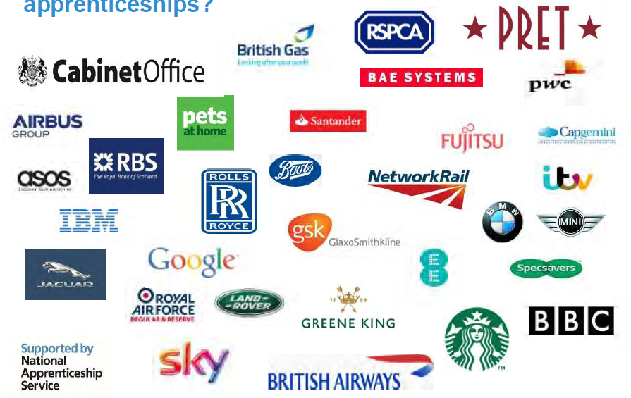
Here are just a few employers who have offered apprenticeships in recent years…
Notes:
So, here are just a few employers who have offered apprenticeships in recent years. The majority of them will make use of the National Apprenticeship Service but there may be some who choose to advertise separately on their own website. So once a student has chosen which area or sector they would like to work in, it is important that they are proactive in checking the various search engines and relevant company websites so that they don’t miss out on any opportunities.

Slide 28
How hard is it to get an apprenticeship?
This really depends on which area/industry you are looking to go into, and what is available in the local area. Lots of advice from Personal Tutors
You need to ensure that you have an excellent application to make you stand out from other candidates – make sure you make the most of any virtual opportunities.
Student still complete a Personal Statement that can then be ‘tweaked’ to specific applications.
Notes:
Now, this is a question that we are often asked – how hard is it to get an apprenticeship? And the answer really depends on what industry your son or daughter is looking to go into, and also how proactive they are in searching for the right apprenticeship. And as I’ve already said, the current pandemic will undoubtedly have some impact.

Slide 29
February 2023
National Apprenticeship Week
Where will I find apprenticeship vacancies?
There is a lot of information available on the Post-18 Google Drive about apprenticeships. The following websites would be the best places to go to start your search:
https://www.findapprenticeship.service.gov.uk/apprenticeshipsearch
https://careerfinder.ucas.com/jobs/apprenticeship/#browsing
How do I find out more information?
https://www.apprenticeships.gov.uk
https://www.ucas.com/understanding-apprenticeships
Notes:
So what can students do to find apprenticeships? Well, on the Post 18 Options Drive, students already have access to a whole list of websites that they should hopefully have started to look at to help them get a few more ideas. I have also included a few of these links here but the best websites to use are the UCAS hub and the main government website. For the current year 12 students, the majority of vacancies will be released from February/March time in 2022, usually following on from National Apprenticeship Week. At the moment, we are asking all students to write a personal statement, even if they are hoping to secure an apprenticeship, as this helps to get them thinking about their own skills and experiences, and how can apply and develop these through employment and education. Students will then be able to take sections of their statement to help them write their apprenticeship application, or a CV on the off-chance that one is required. It is important that students use every opportunity to find out more about the sector they would like to work in, and, just as with those students applying to university, we would strongly advise students to complete work experience in their chosen industry whether that face-to-face or virtual.

Slide 30
Employment:
https://www.gov.uk/find-a-job
https://uk.indeed.com
https://www.careerbuilder.co.uk
There will be a number of careers events for students to attend (either in person or virtually) in Spring 2023.
Students should also register for the main job search websites so that can be alerted when new jobs become available. They may also wish to download a job search app.
There is also additional information in the Employment folder in the 2023 Post 18 Options drive.
Notes:
And finally, some of our students might chose to go straight into employment. There will be a number of careers events for students to attend in Spring 2022, but in the meantime, students should once again be proactive in registering for the main job search websites, for instance, Indeed or Find A Job so that they can receive alerts and up-to-date information.

Slide 31
Still struggling?
Students should visit the Unifrog website there are a number of videos about how to use Unifrog if a student is struggling with their post 18 choices.
Students should speak to their teachers, Personal Tutor, or Head of Year
It is natural for students to feel anxious. The main thing that we can do to support students is to offer guidance and advice, and ultimately, reassurance that everything will be ok in the end, even if they choose a pathway that is slightly different to their friends.
Notes:
Now if your son or daughter is still struggling, they should firstly visit the Unifrog website, which has a whole section of ideas and resources for those students who don’t know. Once they have done this, if they are still struggling, then they need to go and see their tutor or come and see me so that we have a discussion about all of the various options.
And, finally, I’d just like to say that it is very natural for students to feel anxious, especially given the current situation. The main thing that we can do to support students is to offer guidance and advice, and ultimately, reassurance that everything will be ok in the end, even if they choose a pathway that is slightly different to their friends.

Slide 32
How can you support son/daughter Post-16?
Research/Sign up
Use the parents/guardians’ section of the UCAS website at www.ucas.com/parents and sign up for parent updates or register for the Parents’ and Carers’ Pack at Amazing Apprenticeships.
Open days/Work Experience
Attend virtual events and open days – you may have a different perspective. Encourage your son/daughter to complete work experience in their chosen field or industry.
Be proactive
Please make sure they read everything carefully that is sent to them (and that they are regularly checking the Post 18 Drive and Y13 Conference Classroom for updates, and try to avoid booking holidays at key times.
Work (academic & paid)
Social life.....
Support (Key times)
Security marking: PUBLIC
28 September 2022
| 32
Notes:
And here are just some ideas to things that you can do as parents and carers to support them. The updates from UCAS and the Parents’ Pack from Amazing Apprenticeships have been particularly useful for parents in the past and they do offer a lot of current, up-to-date advice. Students will also need to be regularly checking the Post 18 Options Drive and the Conference Classroom for updates and opportunities, and we would really appreciate your support with encouraging students to be proactive in checking these platforms and not turning off their notifications!

Slide 33
If you have any further questions please contact – ekelleway5nr2@nsix.org.uk Do come over and see the BRAND new refurbished Sixth Form Otherwise – thank you for attending - safe journey home!
A copy of this PowerPoint will be emailed to all parents/carers.
Notes:
So, all that remains for me to say is thank you for joining me this evening. If you do have any questions, you can contact me via email or by telephoning the Sixth Form. A recording of this presentation and some accompanying materials will be sent out to all parents and carers tomorrow via email. Alternatively, I’m more than happy to take any questions now if you’d like to ask or write in the chat box. If not, again, thank you for joining me this evening.

