Slide 1
GCSE Geography Revision

Slide 2
Geography syllabus & Assessment Objectives
GCSE Geography (8035)
PAPER 1 Living with the physical environment | PAPER 2 Challenges in the human environment | PAPER 3 Geographical Applications
CHALLENGE OF NATURAL HAZARDS Tectonic hazards Weather hazards Climate change Geographical skills | URBAN ISSUES & CHALLENGES Urban growth Urban change in UK cities Sustainability Geographical skills | ISSUE EVALUATION, Critical thinking & problem solving to a geographical issue provided by the exam board.
LIVING WORLD Ecosystems Tropical rainforests Cold environments Geographical skills | THE CHANGING ECONOMIC WORLD Economic development Social, economic & cultural change Economic features of the UK Geographical skills | FIELDWORK & SKILLS Unseen fieldwork in contrasting environments (coast & city) Geographical skills
PHYSCAL LANDSCAPES OF THE UK. UK physical landscapes Coastal landscapes River landscapes Geographical skills | THE CHALLENGE OF RESOURCE MANAGEMENT Resource management Food Geographical skills
Worth 35% & 88 (+3SPG) marks | Worth 35% & 88 (+3SPG) marks | Worth 30% & 76 (+6 SPG) marks
1 hour 30 min exam | 1 hour 30 min exam | 1 hour exam
Assessment Objectives (AOs)
Assessment objectives (AOs) are set by Ofqual and are the same across all GCSE Geography specifications and all exam boards.
The exams will measure how students have achieved the following assessment objectives.
•AO1: Demonstrate knowledge of locations, places, processes, environments and different scales (15 % of exam).
•AO2: Demonstrate geographical understanding of: concepts and how they are used in relation to places, environments and processes; the interrelationships between places, environments and processes (25 % of exam).
•AO3: Apply knowledge and understanding to interpret, analyse and evaluate geographical information and issues to make judgements (35 %, including 10 % applied to fieldwork context(s)).
•AO4: Select, adapt and use a variety of skills and techniques to investigate questions and issues and communicate findings (25 %, including 5 % used to respond to fieldwork data and context(s)).

Slide 3
WEBSITES
www.geographycat.co.uk -great revision tips, printable flashcards & exam practice.
www.rgs.org -Royal Geographical Society
www.internetgeography.net – internet geography, exam practice, quizzes
www.geoggle.co.uk – audio clips, videos, downloadable worksheets, recall quizzes
YOUTUBE
Mr B -AQA Geography- covers every topic on the syllabus.
Ramsey Geography
INSTAGRAM
mr_b_btecpe -AQA Geography revision of all topics & exam techniques
ramsey_geography -Revision tips paper by paper, exam tips
geography_cat -in the run up to the exams she posts 3 revision cards per day on all topics. These can be screen shot & used.
Internetgeography
mrvisgeography
Geography_explained_online
gcsegeo
Instagram, You Tube sites for Geography revision

Slide 4
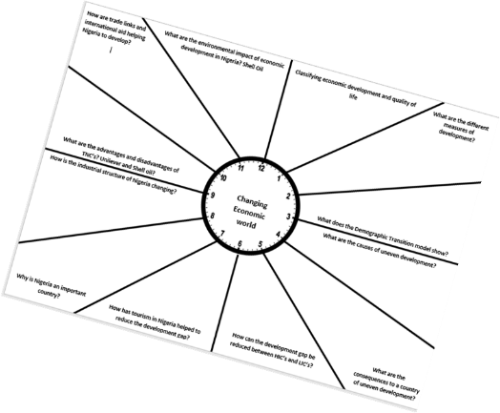
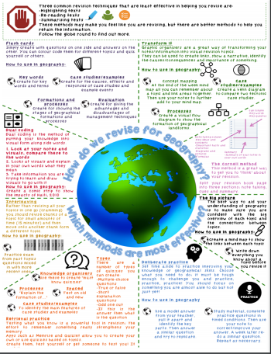
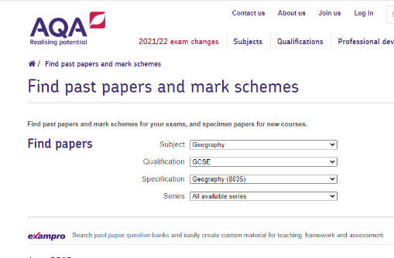
School revision resources
AQA past papers

