Slide 1
GCSE Options Assembly Drama

Slide 2
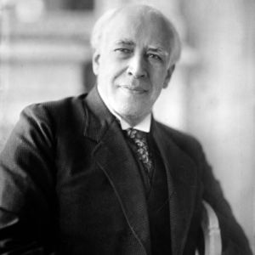
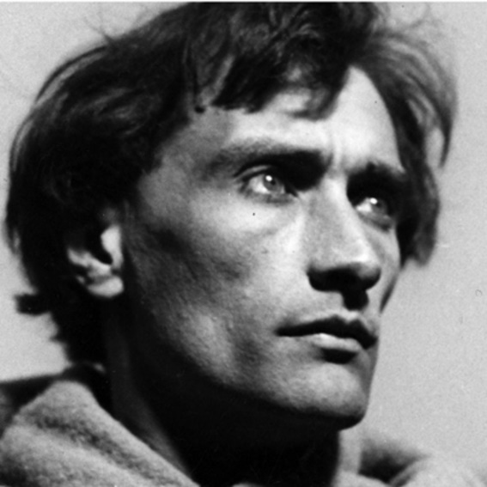
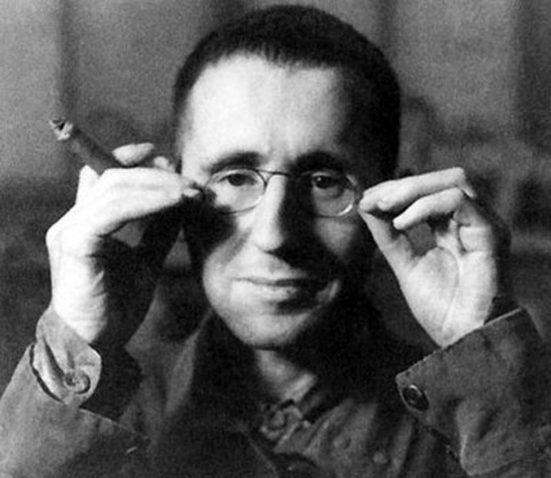
Overview
Students study drama provided by the AQA exam board across 2 years. The course is divided into both written and practical components at a ratio of 70:30.
Students will study 5 schemes across the 2 years:
Practitioners, Mechanics and Processes
Blood Brothers
Devising Drama
Texts in Practice
Understanding Drama

Slide 3
Component 1: Understanding Drama
Written Exam. 1 hr, 45 mins. 3 sections, 80 marks in total. 40% of GCSE.
What’s assessed?
Section A: Theatre Roles and Terminology (4 marks) - in this section, students will be tested on their knowledge of theatrical roles and terminology, including types of staging, the various jobs and responsibilities and how these are applied to real life theatre. This section is made up of multiple choice questions.
Section B: Study of Set Text (44 marks) – students have studies Blood Brothers as the set text for the exam. They have to answer 4 questions on the text. These questions surround design aspects, how to approach specific lines and extracts and how to apply vocal and physical skills to characters. The questions are worth 4, 8, 12 and 20 marks.
Section C: Live Theatre Production (32 marks) – students will have seen a piece of live theatre. They will have made extensive notes and studied the acting skills of the performers. This sections requires students to answer one question, showing their ability to describe the skills used and analyse their effectiveness in the context of the piece. Students will receive a maximum of 12 marks for their ability to describe and a maximum of 20 for their ability to analyse.

Slide 4
Component 2: Devising Drama
Practical devised performance, worth 20 marks. Written devising log comprising of 3 sections, worth 60 marks in total. Total of 80 marks available, 40% of GCSE.
What’s assessed?
Students are put into groups and presented with a range of stimuli. These may be images, songs, poems, pieces of art, videos etc. This devising component requires students to collaborate and devise a piece from scratch, based on one of the stimuli. This is then performed under exam conditions and recorded.
Alongside the practical devising of the piece, students are required to provide a written log of their individual process. This log is divided into 3 sections (written at different point along the process), worth 20 marks each. Students will comment on their response to the stimulus at the start of the process, their development and collaboration when the piece has been finalised and their analysis and evaluation after the piece itself is performed.
There are also stipulations with regard to length and exam processes that need to be adhered to. Students are marked individually for this component and it is marked internally by the subject teacher.

Slide 5
Component 3: Texts in Practice
2 practical performances, worth 20 marks each.
What’s assessed?
Students are assessed on their ability to respond to a text. It is encouraged that these texts are chosen by the students, but the subject teacher can have input too.
Students are tasked with identifying and exploring two key extracts, from the same script. These extracts are to be performed. Students can choose monologues, duologues and group pieces, which can be mixed and matched as necessary (i.e. 2 monologues, 1 of each etc.), provided they are from the same piece.
These performances should show students’ array of practical skills and ability to interpret texts and form a clear character. Again, there are stipulations in terms of length, texts etc. that must be adhered to.
These extracts are again performed in exam conditions and recorded. This component is marked by a visiting examiner.

Slide 6
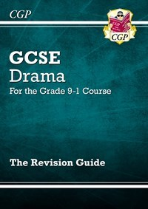
Preparing
CGP revision books
A selection of these are on order and can be purchased by liaising with Mr. Frost.
GCSE Pod
Teachers are regularly setting homework using this and there are a wealth of Pods for you to access. Make sure when you watch a pod that you are completing some questions to assess your understanding.
Questions from past papers
These will also be made available from the subject teacher.
Any other revision homework set by your child’s English Teacher
This might include research tasks, BBC Bitesize, PiXL, reading plays etc.

