Slide 1
ART & DESIGN GCSE
Teacher Miss Bivar Segurado

Slide 2
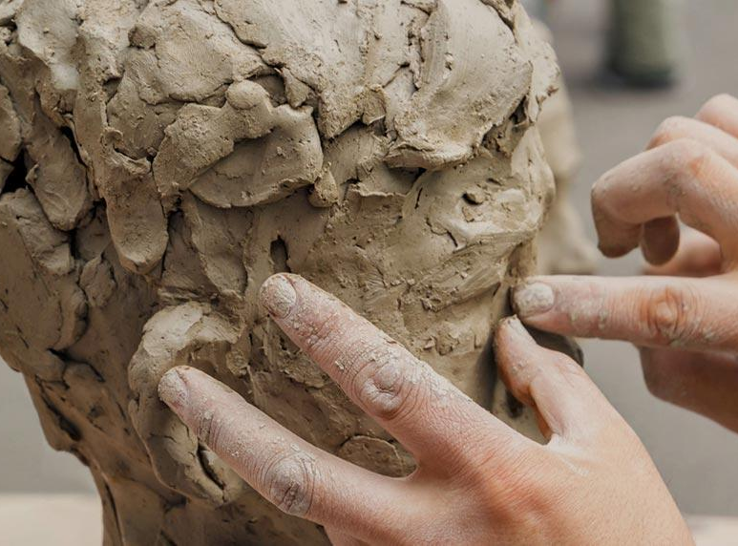
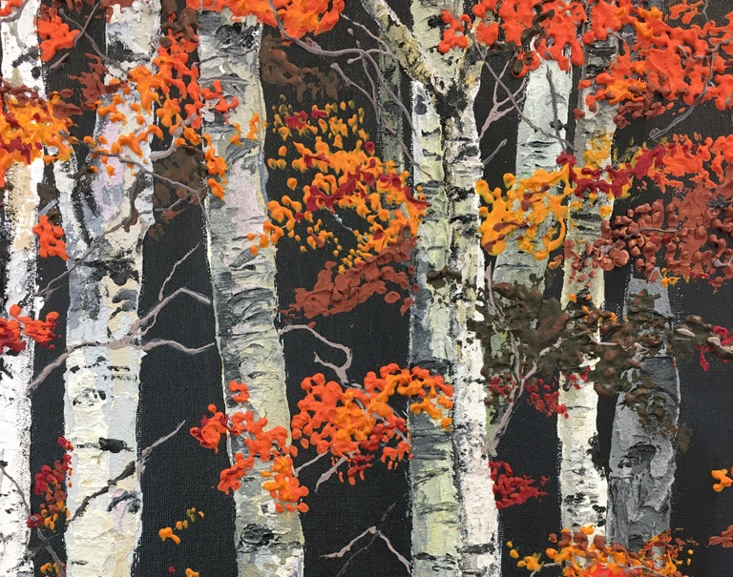
GCSE Art & Design- Pearson Edexcel Fine Art Component 1: Personal Portfolio 60% please note 72 marks (18 marks for each of the four assessment objectives) Component 2: Externally Set Assignment 40% please note 72 marks (18 marks for each of the four assessment objectives)

Slide 3
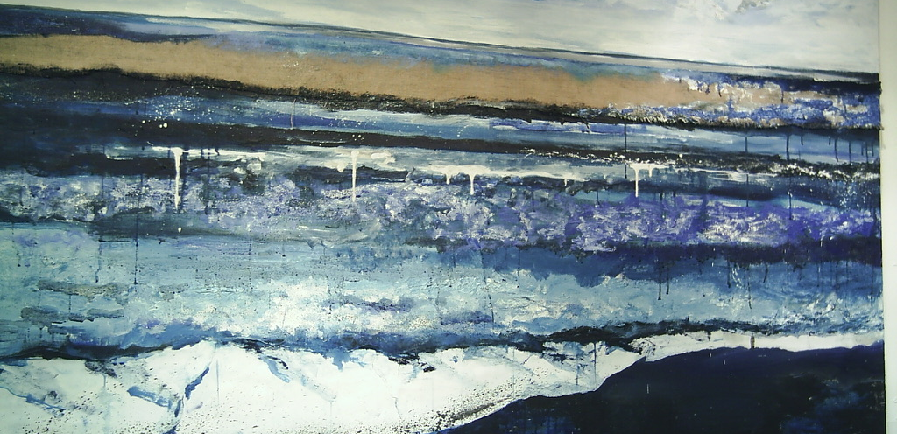
What Does Art & Design Involve
Drawing
Photography- digital
Mix media- 3-D
Printing
Painting
Sculpture
What can we do to support our children
Homework- is a regular thing in art, staying on top of the coursework is an important skill- the art is open most days if needed.
Recording - for example photos, drawings from real life e.g. buildings.
Researching- finding out about the old and new artists is key to developing their skills too.

Slide 4
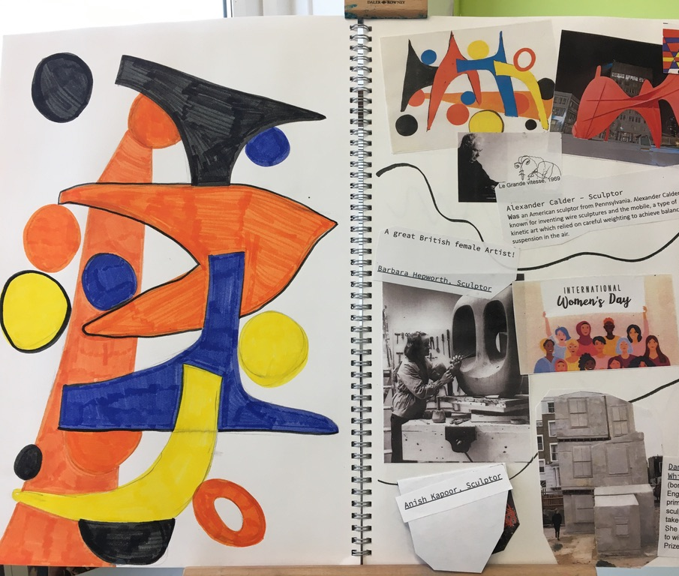
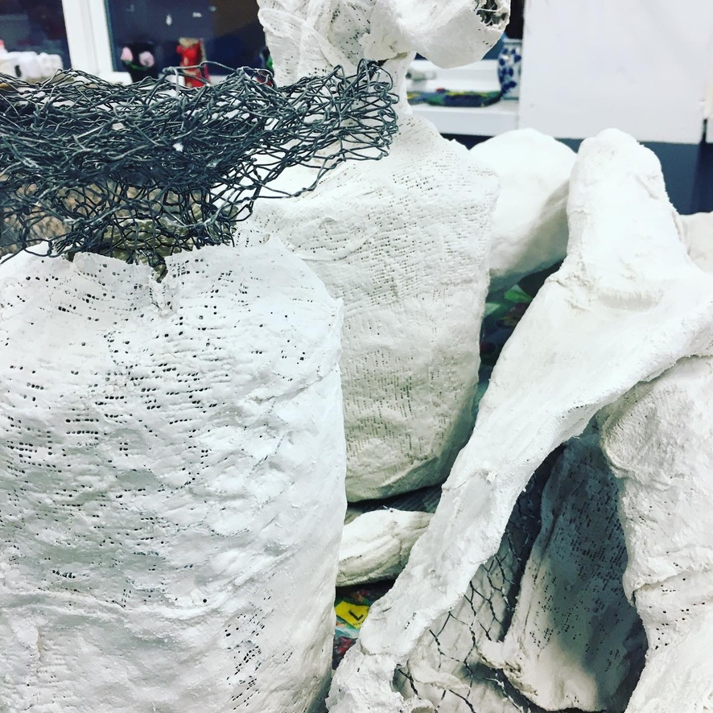
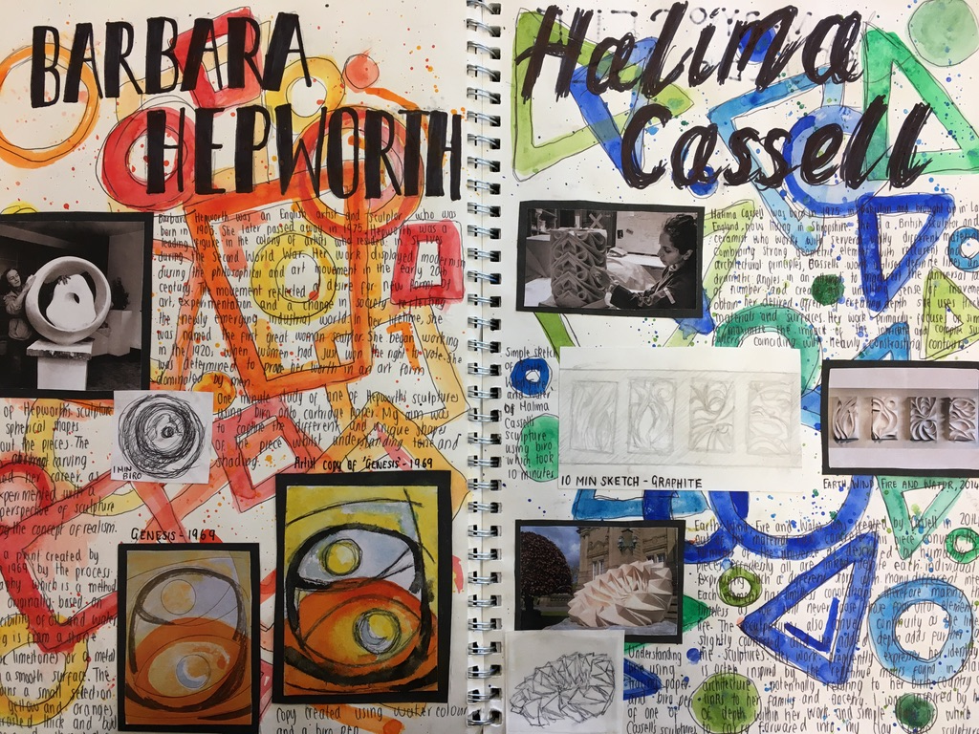
How the course is structured
Year 10
Creating a personal portfolio (60% of qualification), including sketchbooks, mix media and artist research form part of this.
Three coursework projects are set throughout this academic year- with an expectation of homework to be carried out regularly, to ensure the coursework is kept up to date.
Internally set assignment will be set and each project will end in a detailed completed final piece.
Year 11
Creating a personal portfolio (60% of qualification), including sketchbooks, mix media and artist research form part of this.
One coursework project is set throughout this academic year from September to December/January- with an expectation of homework to be carried out regularly, to ensure the coursework is kept up to date.
Externally set assignment (40% of qualification) including research, sketchbooks, artist research and material developments. This ends with a 10 hours final exam, where you produce your final piece in exam conditions.

