Slide 1
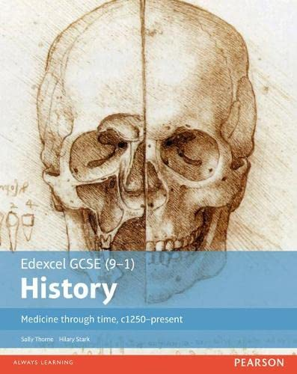
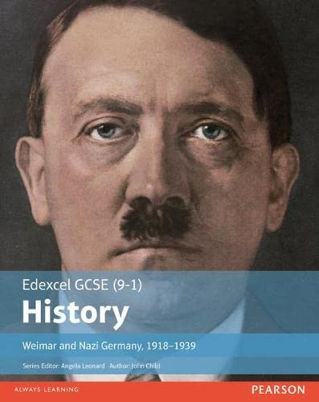
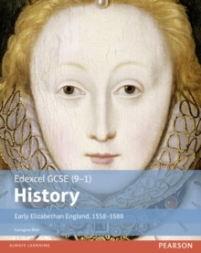
GCSE History Revision

Slide 2
Assessment
Three exam papers; four units covered
Paper 1: Medicine through time, c.1250-present and the British Sector of the Western Front, 1914-1918: injuries, treatment and the trenches
Paper 2: Early Elizabethan England, 1558-1588 and Superpower Relations and the Cold War, 1941-91
Paper 3: Weimar and Nazi Germany, 1918-1939

Slide 3
Assessment Objectives

Slide 4
Revision Zone
https://drive.google.com/drive/u/1/folders/1z3XTrwoQMsD41F5X7DimpoHJ0oDx-AV0
Access for revision guides, past papers, model answers and more for all four units of the History GCSE course.

