Slide 1
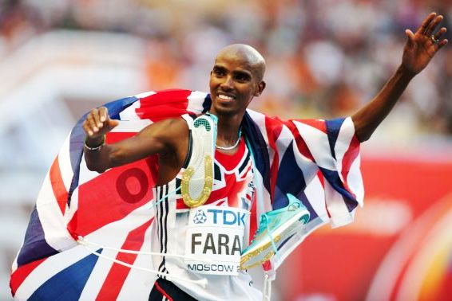
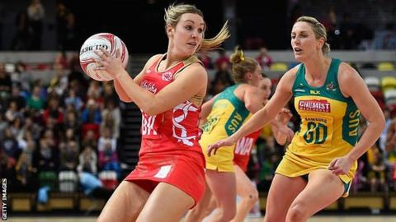
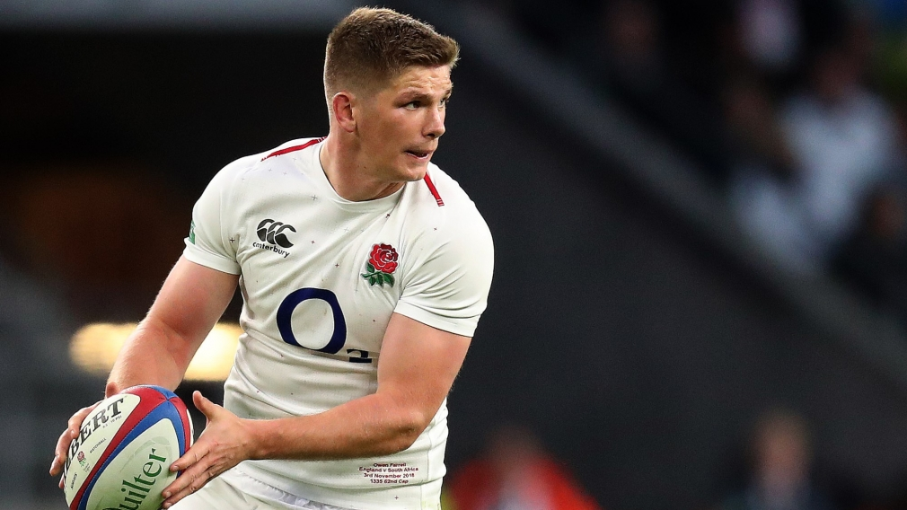
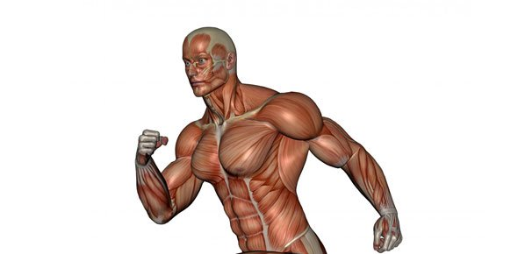
GCSE Physical Education
INFORMATION EVENING 2022

Slide 2
GCSE PE Specification
The GCSE PE specification is broken down into the following:
Component 1 – Physical factors affecting performance
Component 2 – Socio-cultural issues and sports psychology
Component 3 – Practical performance
Component 4 – Analysing and Evaluating Performance (AEP)

Slide 3
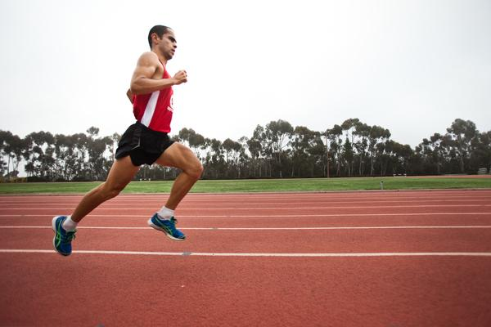
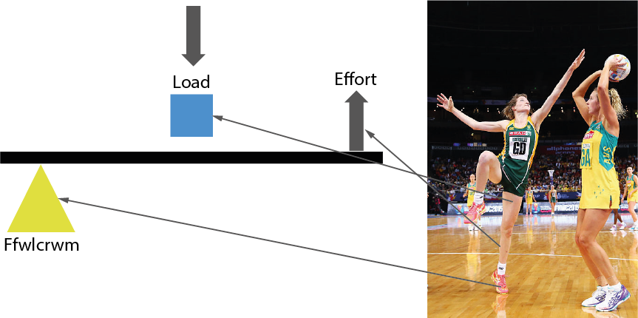
Component 1 – Physical factors affecting performance
Written examination in June 2023 (1 hour)
This equates to 30% of your child’s final grade
Content overview
Topic 1 – Applied anatomy and physiology
Topic 2 – Movement analysis
Topic 3 – Physical training
Topic 4 – Use of data

Slide 4
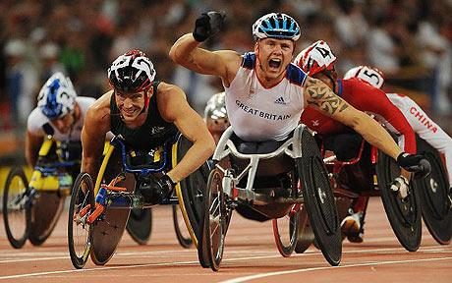
Component 2 – Socio-cultural issues and sports psychology
Written examination in June 2023 (1 hour)
This equates to 30% of your child’s final grade
Content overview
Topic 1 – Health, fitness and well-being
Topic 2 – Sport psychology
Topic 3 – Socio-cultural influences
Topic 4 – Use of data

Slide 5
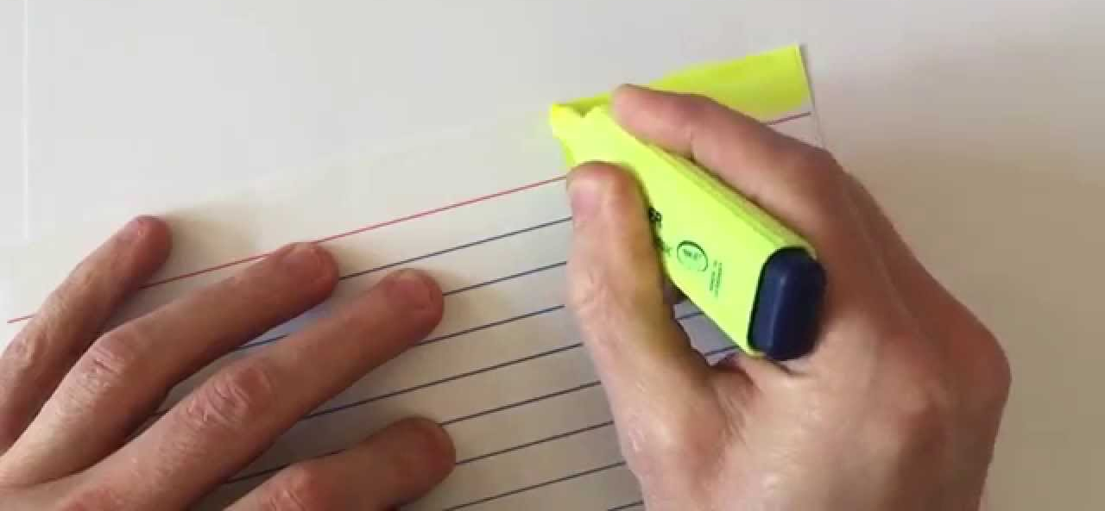
Revision guides and materials

Slide 6
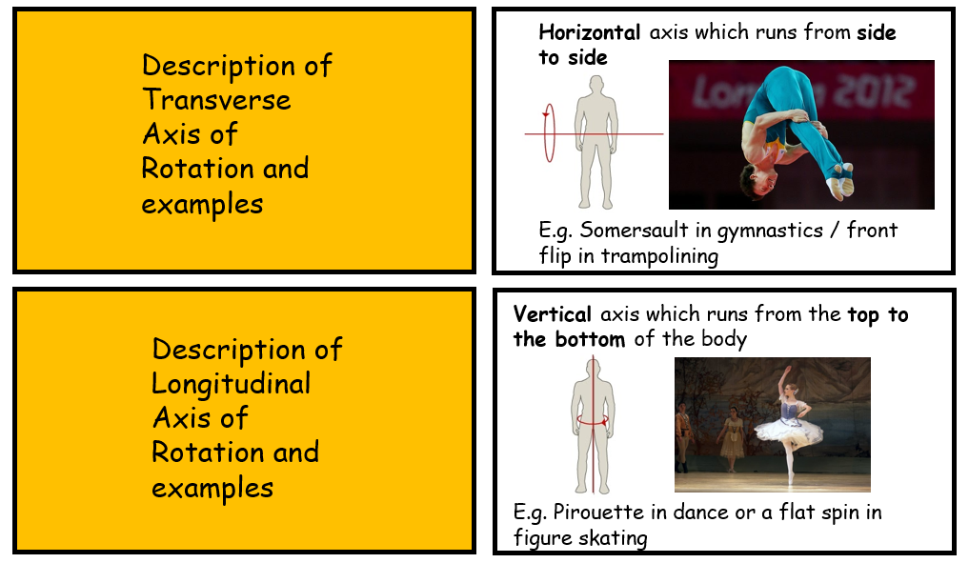
Revision guides and materials
I have created bespoke flash cards for OCR GCSE PE and I have set these as homework to create. Please ensure your child has all seven sets.
These are great for little and often revision and testing your child with these regularly will really help improve exam grades

Slide 7
Component 3 – Practical performance
Practical examinations in 2023 in three different sports/activities.
This equates to 30% of your final grade
Assessment overview
Activity 1 – Team activity
Activity 2 – Individual activity
Activity 3 - Free Choice

Slide 8
Key information for practical assessment
The internal assessment day is in early March 2023. I then submit marks to OCR before 31st March and then a sample from 5 different sports is selected by them.
This will be live moderation (at a hub school) or video evidence (if offsite activities)
This will consist of 1 hour assessments on different sports
Students will leave lessons for their assessment slot (please arrive 10 minutes before to be prepared)

Slide 9
Key information for practical assessment
Off-site activities videos will need to submitted by February Half Term (e.g. equestrian, swimming and skiing)
I have been in contact with parents regarding some activities which are classed as onsite but may need to be observed in their club or specialist setting (e.g. girls rugby, squash, gymnastics)
If you feel your child needs me to come and observe in different settings then please contact me.
I would strongly advise gathering club or county footage of your child performing to assist with marking.
**Please remember to seek the appropriate permission to film the matches/performances from both teams/competitors.

Slide 10
Component 4 – Analysing and Evaluating Performance (AEP)
This is the coursework component and equates to 10% of your final GCSE grade.
The purpose of this component is to:
Analyse aspects of personal performance in a practical activity
Evaluate the strengths and weaknesses of that performance
Produce an action plan which aims to improve the quality and effectiveness of that performance.
We are nearing the end of the time being spent on this in class so it is vital your child works hard and plans for each session. After this time we will move to lunchtime 30 minute sessions once per week as we must continue with the examination content.

Slide 11
Grade Boundaries
Exam 1 – Physical factors affecting performance (60 marks)
Exam 2 – Socio-cultural issues and sports psychology (60 marks)
Practical performance (60 marks)
Coursework - Analysing and Evaluating Performance (20 marks)

