Slide 1
Sports Studies 22-24

Slide 2
What will we be studying over the next two years?
R184 Contemporary Issues in Sport—exam worth 40% overall (70 marks)
R185 Performance and Leadership in Sports Activities—coursework worth 40% overall (80 marks)
R186 Sport and the Media—coursework worth 20% overall (40 marks)

Slide 3
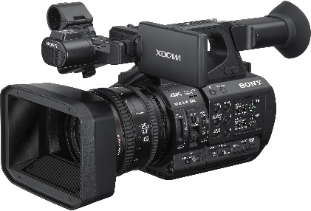
R184 Contemporary Issues in Sport
This module will be assessed with a 1 hour 15 minute written exam which will have 3 sections, this will be out of 70 marks in total.
Topic Area 1, you need to know:
· Know the user groups that participate in the physical activity or sport
· Know and understand the possible barriers which affect participation in sport
· Know and understand possible solutions to the barriers which affect participation in sport
· Know and understand the factors which can positively and negatively impact upon the popularity of sport in the UK
· Know and understand the growth of emerging/new sports in the UK
Topic Area 2, you need to know:
· Know and understand sport values
· Know the Olympic and Paralympic movement
· Know and understand sporting values, initiatives and campaigns
· Know and understand the importance of etiquette and sporting behaviour
· Know and understand the use of performance enhancing drugs (PEDs) in sport
Topic Area 3, you need to know:
· Know and understand the features of a major sporting event
· Know and understand the positive and negative pre-event aspects of hosting a major sporting event
· Know and understand potential positive and negative aspects of hosting a major sporting event
Topic Area 4, you need to know:
· Know and understand National Governing Bodies (NGBs)
Topic Area 5, you need to know:
· Know and understand the role of technology in sport
· Know and understand the positive and negative effects of the use of technology in sport

Slide 4
R185 Performance and Leadership in Sports Activities
This unit is assessed through 5 practical tasks, each of which needs to be evidenced. It is out of 80 marks in total.
Topic Area 1, you need to:
· Perform in two selected activities
· Participate in making appropriate use of tactics, strategies, compositional ideas and creativity in performance
· Demonstrate decision-making during performance
· Manage and maintain performance in individual activities
· Manage and maintain performance in team activities
Topic Area 2, you need to:
· Review the strengths and weaknesses of your sports performance
· Use methods to improve performance
· Measure improvement in performance
Topic Area 3, you need to:
· Understand how to organize a sports activity session
· Understand safety considerations when planning a sports activity session
· Set objectives to meet the needs of the group
Topic Area 4, you need to:
· Organize a sports activity session
· Deliver a sports activity session
Topic Area 5, you need to:
· Review your leadership of a sports activity session

Slide 5
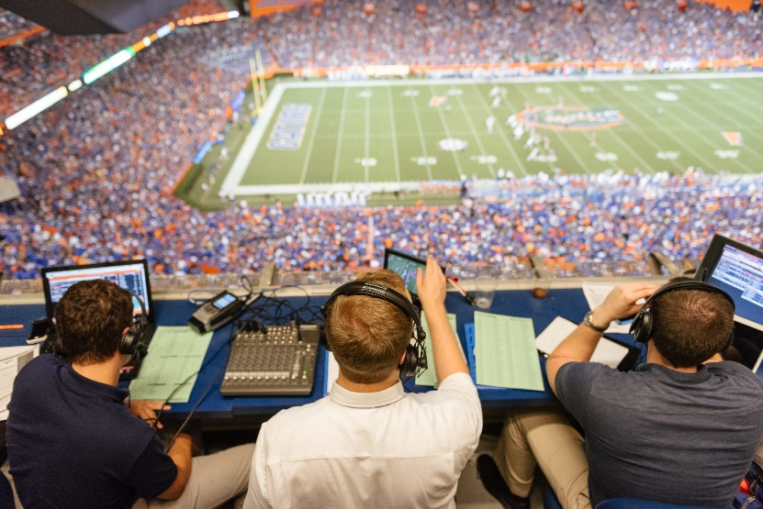
R186 Sport and the Media
This unit is assessed through 3 practical tasks, each of which needs to be evidenced. It is out of 40 marks in total.
Topic Area 1, you need to:
· Demonstrate understanding of the different media sources relevant to an actual club or chosen sport
· Provide links to different media sources and provide examples of how media might be used to provide information to a club’s spectators
· Give recommendations of the media sources that would be of most benefit to a club
Topic Area 2, you need to:
· Demonstrate knowledge of the positive impacts of the media for a club or sport
· Provide examples that demonstrate evaluation of the relationship between a sporting activity and the media
· Provide recommendations as to which media source a club or sport should spend funding on
Topic Area 3, you need to:
· Demonstrate knowledge of the negative impacts of the media for a chosen sporting activity
· Provide reference to the ethical issues surrounding the use of media for a chosen sporting activity
· Provide local and national examples that demonstrate knowledge covering spectators and participants for a chosen sporting activity

