Slide 1
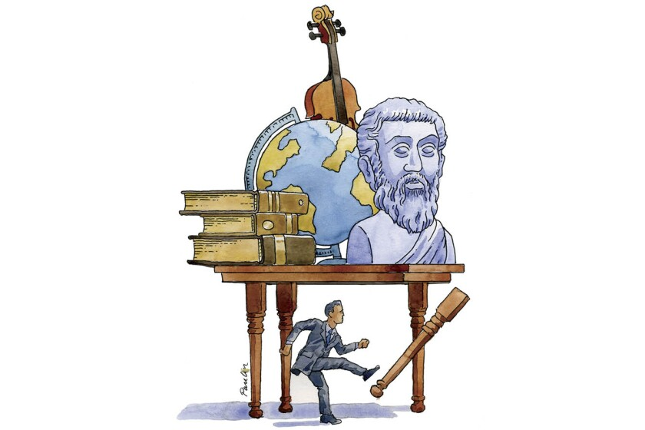
Humanities Faculty
GCSE Revision Information

Slide 2
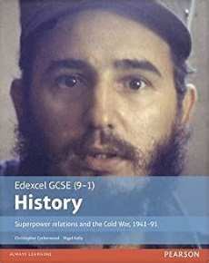
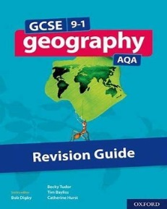
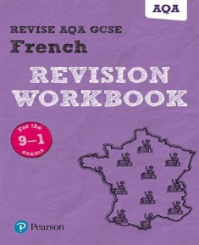
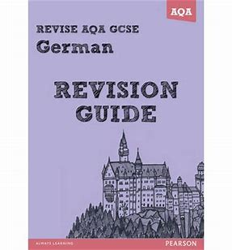
How to maximise your potential in History, Geography, German and French
Step x Step guide to answering: How useful are sources B and C for an enquiry into……
How useful….(8 marks)
1. State how useful : very/partially/somewhat
2. Prove it: quote the source – make sure the quote is relevant to the enquiry
3. Make a relevant inference – make sure it is supported by the quote used
4. Add relevant own knowledge – relevant to the enquiry
5. Comment on how NOP effects utility – nature; origin; purpose
6. Comment on limitations if they are obvious e.g. biased; short extract etc.
7. Repeat the same process for Source C in a new paragraph
Make sure you have revision materials for the relevant subject.
Practise exam questions – revise the topic in the question first then allow yourself the time you’ll have in the exam to answer it e.g. 4 marks = 5 minutes
Follow step x step (structure) guides provided by your teachers
Use the structure for answers suggested by teachers; how to start each answer e.g. One reason…; One key feature…; Source B is partially useful… etc.
Attend revision sessions – ask what the focus is beforehand/agree a focus
Get into the habit of highlighting/underlining words in the questions; use WFTQ in your answers; read your answers, ensure you link them to the question.
Ensure your work in class is completed and as detailed as possible to aid your revision
For languages, practise speaking and listening as often as possible
Use the teachers in the faculty. They will mark additional exam answers; put on focused revision sessions and do all they can to help you maximise your potential.

Slide 3
Revision Zone - History, Geography, German and French
https://drive.google.com/drive/u/1/folders/16C3ZSdMz3urTwD22GVOZiDxpAakZit6C
There are folders for each Humanities subject on the Revision Zone
Make sure you use the resources provided to support you with revision of content and to develop your exam skills
E.g. History - a range of revision guides, workbooks, revision resources, past papers, mark schemes etc.

