Slide 1
WELCOME TO MATHS
YEAR 11 REVISION INFORMATION

Slide 2
AIMS OF THIS POWERPOINT
The main aim of this session is to re-familiarise yourselves with the various resources available to you during your revision for your Maths GCSE exam.
During the session, various websites and other resources will be highlighted and login information will be provided.
All resources will be available from the “Revision Folder”

Slide 3
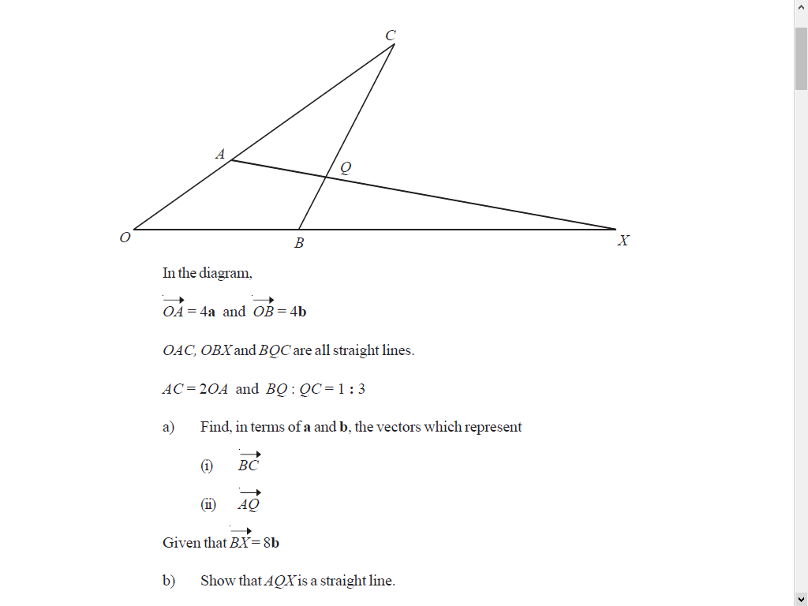
MATHSWATCH
Regularly used to aid the recall of core concepts as well as support the development of new material
Questions follow the same style as the GCSE papers
Longer support videos or ‘one minute maths’ videos for a quick reminder.

Slide 4
KERBOODLE
This is a website that the school subscribes to that gives all GCSE students access to their actual textbooks, live online. This means that students can access any page of their textbook as well as many linked resources including video clips that explain strategies and concepts clearly.
The books include the solutions to all problems.
There is also a homework book online, useful for extra practice.
Each exercise page of the text books has 4 digit references to MyMaths activities for further explanation and practice.
Students will also have links to Geography resources through the same login.

Slide 5
PIXL
PiXL is an organisation set up by teachers for teachers.
There is a wealth of resources they have developed for multiple subjects.
They have also developed the “PiXL Maths App” which is downloadable on any Windows, Apple or Android device or desktop computer.
EVERY student in the school has access to this.
In particular, for year 11, there are “Walking Talking Mocks” (WTMs) which have past papers and videos of someone working through them.
Besides this, there are tests, challenges and activities designed to help with any part of the curriculum, including a useful Arithmetic section.

Slide 6
DFM – Dr Frost Maths
All pupils can register with their school email address, speak with Mr Scott if you need any support with this.
Topics broken down into small units
Pupils have the ability to focus their revision exactly where it is needed, whether that need is key skill practice, problem solving or exam questions.
Creates a ‘clean up’ folder of all tasks where mistakes have been made so that you can revisit at a later date.
Help videos available alongside questions and skills have a code which can help with identifying the key topic if it needs further revision
Past papers and solutions available

Slide 7
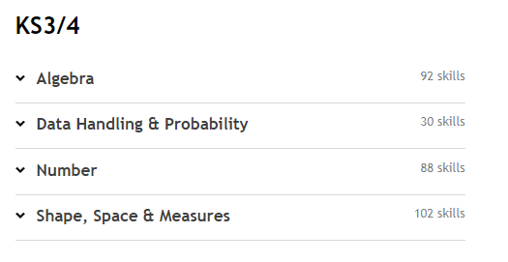
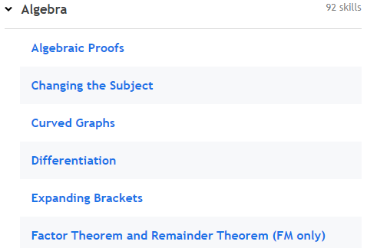
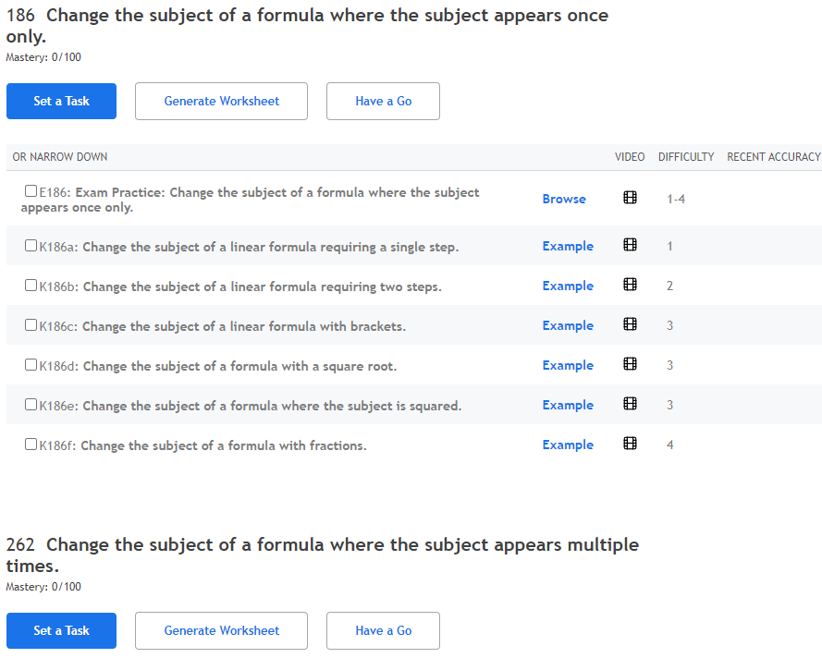
DFM – Dr Frost Maths

Slide 8
PAST PAPERS
AQA are the exam board that Acle Academy uses for its Maths GCSEs.
They have a website where students can get access to past papers and solutions without the need for a login. (Login needed for latest papers but these will be given in class). Choose “Mathematics 8300”.
They also have other resources accessible by students and parents.
This is probably one of the most effective ways to revise for Maths!
It’s worth trying past papers from other exam boards too, such as Edexcel.

Slide 9
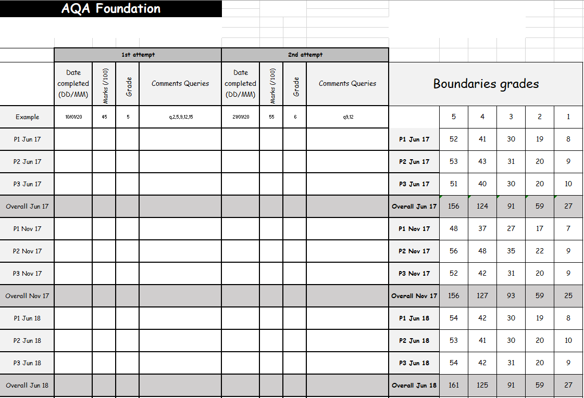
PAST PAPERS
A tracking sheet is available to keep a record of your progress.

Slide 10
IN HOUSE REVISION SESSIONS
The Maths department staff regularly give up their time to help students on an ad hoc basis.
In addition, we provide the opportunity for students to attend a number of sessions throughout the week.
We also provide period 6 Tuesday sessions for selected students where exam questions are presented in a WTM style.

Slide 11
THE EXAM - REMINDER
The exams comprise 3 papers, 1 non-calculator and two calculator.
Each paper is worth 80 marks and lasts for 90 minutes.
Students should have their own Maths equipment including a scientific calculator. This is so they are familiar with how these things work since invigilators cannot help with these, and we cannot guarantee enough equipment for everybody in the exam.
It’s good practice to skim the paper first and then to start with easy questions to help settle nerves and get the exam underway.
Never sit and do nothing. Spare time should always be used to gain more marks and check answers.
Have a go. You cannot lose marks, they can only be gained.

Slide 12
USEFUL RESOURCES SHEET (AVAILABLE VIA GOOGLE CLASSROOM).

Slide 13
THANK YOU!

