Slide 1


Firside Junior School Newsletter
Become the best that you can be: for learning, for life, for future success.
Friday 10 May 2024

Slide 2

Head Teacher’s message
Dear Parents and Carers,
It has been wonderful to finally see some better weather over the last few days. Sunnier days has meant that children have been able to enjoy all of their break times and lunchtimes outsider and some classes have also taken their learning outside too. Let’s hope it continues! As the weather improves, please send your child to school with a named water bottle, named hat and, if needed, sun cream (named also) which they can apply themselves. We would recommend sun cream is also applied before school.
Next week is a big week for Year 6 as they take their national SATS tests. The children have worked incredibly hard in the build up to these and we are so proud of each and every one of them. We know that they will do what we keep reminding them to do: just to do the best they can. We know that these assessments are just a snapshot of our amazing Year 6 children and do not test their ability in other areas of the curriculum such as art, music, science or PE and nor are they an assessment on their other personal attributes and skills. Once again, we have organised a special SATS breakfast for children in Year 6 next week (Monday to Thursday) from 8am to set the children up each day. We would encourage parents to ensure that the children are getting plenty of rest over the weekend and next week. We wish all of our Year 6 pupils the very best for their tests.
Kindest regards,
Mrs Robinson (Head Teacher), Mr Keer (Deputy Head Teacher) and Mrs Seagrave (Senior Teacher)

Slide 3
Dates for your diary
13 - 16 May Year 6 SATS week
20 - 22 May Year 6 residential
20 and 21 May Bikeability sessions for selected children in Year 4
Fri 24 May Last day of Summer 1 term
Mon 3 June First day of Summer 2 term
3 - 14 June Year 4 multiplication check window opens (children will complete it during these two weeks)
Tues 4 June Year 3 tag-rugby coaching
Fri 7 June Year 6 tag-rugby coaching

Slide 4
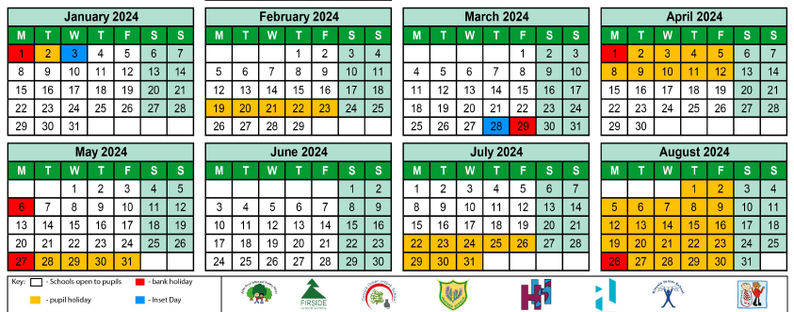
Diary dates for the rest of the school year

Slide 5
Uniform reminder
Now we are into the summer term, children are welcome to wear summer uniform (summer dresses and shorts).
We will continue to ask children to wear their ties until May half term unless we let you know otherwise.
A reminder that PE kit should include black shorts / jogging bottoms, a white logo PE tshirt or plain polo shirt and a black jumper / hooded top or logo fleece. We are having a number of children turning up to school in non-school colours for PE. A full uniform list is available on our website.
We know that lots of the girls prefer to wear cycling shorts for PE but please can we ask parents to ensure that cycling shorts and not too short.

Slide 6
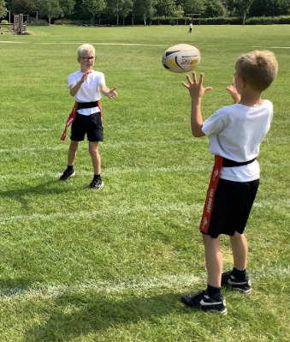
Tag-rugby
Once again this year, we are welcoming North Walsham Rugby Club coaches in to do some fun coaching sessions with each year group. These sessions will take place within the school day. Children should come to school on their tag-rugby day in their PE kit. On their tag-rugby week, children should also wear PE kit on their usual PE / Games lesson days. Year 4 and 5 have taken part in their sessions.
The remaining dates for the sessions are:
Tuesday 4 June Year 3
Friday 7 June Year 6

Slide 7
Accelerated Reading at home
Don’t forget that your children can quiz at home on their Accelerated Reader books using this link.
You can also find out if one of their home reading books is quizzable on AR by using the AR bookfinder website. If it is listed as a book then they can quiz on it.

Slide 8
Rock Notes
We currently have spaces in our Rock Notes choir with Mrs Dance. Sessions are after school on Mondays (£2 per session).
Please contact the School Office if you would like your child to start.

Slide 9


Fish and nut free
A reminder to all families that we aim to be a fish and nut free school. This is due to severe allergies in some children in our school. Please help us to keep them safe by refraining from including fish or nut products in your child’s lunchbox. Nut products might include: whole nuts, nuts in cereal bars, peanut butter and Nutella. Fish products might include, but is not limited to: tuna, salmon, fish paste, fish sticks and prawns. We do not serve fish as a hot dinner or jacket potato filling option.
We ask that all parents follow this guidance as food allergies can be very serious. Thank you.

Slide 10
Uniform for sale
We are now keeping our uniform sale permanently in the School Office where we have a range of second-hand and new uniform for sale.
If you need any pieces, please do pop by the office to see what we have. All items are just £1.
We are always looking for donations of second-hand uniform in good condition. Particularly jumpers, cardigans, ties and PE fleeces. All the money raised from our uniform sales go back into buying things for the school.
We do have a few second-hand coats available too.
Thank you.

