Slide 1



Wells-next-the-sea Primary & Nursery School
SEN information report
Updated September 2025

Slide 2
Contents
A note from our SENDCO | 3 | How we spend SEND funding | 13
What is an SEN Information report? | 4 | Ensuring pupil and family voices are heard | 14
Areas of SEND in our schools | 5 | What to do if you have a complaint | 15
What to do if you have concerns your child may have SEN | 6 | Support services for families of children with SEND | 16
How we identify children with SEN and ensure they make progress | 7/8/9 | Professional support services we work with | 17
EHCPs | 10 | How we support school to school transitions | 18
How we ensure our curriculum and teaching is accessible to all | 11 | Wells-next-the-sea Primary & Nursery School policies and provision | 19
Our expertise and training | 12 | Key Staff and Governors | 20

Slide 3
A note from our SENDCO
Mrs Beck is our SENDCO across Wells-next-the-sea Primary & Nursery School and Burnham Market Primary School
We are very committed to supporting all our SEND children in the best way we possibly can. We treat all children as individuals and work closely with families to ensure they receive the support they need in order for them to have the most positive start to their education.

Slide 4
What is an SEN Information Report
This report is written to help children and their families understand the provision we offer to those with special educational needs and or disability (SEND)
We have a legal requirement to share information with you
We must review it and publish it annually
This requirement is set out in the SEN Code of Practice which can be found here:
SEN Code of Practice
We have worked with our families to ensure this information is clear and hope you find the information you are looking for within! We welcome your feedback and thank you for reading .

Slide 5
Level of SEND in our school
At our school, we pride ourselves on equal opportunity for all. No matter what barriers to learning children may face, we work together with the child, their family and teaching team to ensure they make good progress and are able to enjoy every aspect of school life.
The pie chart represents percentages of primary need in each area of SEND.
Please note pupils may have secondary needs that are NOT represented in this data.

Slide 6
What to do if you have concerns that your child has SEN
Our classroom teachers always welcome open and supportive conversations around a child’s progress in any area of the curriculum. They are the primary point of contact and can be reached via email through the school office:
office@wells-next-the-sea.norfolk.sch.uk
They are also available at the end of the school day for a short discussions or to arrange a more formal meeting.
The SENDCO Mrs Beck also warmly welcomes communication with families and can also be contacted via email: ebeck6nr5@nsix.org.uk

Slide 7
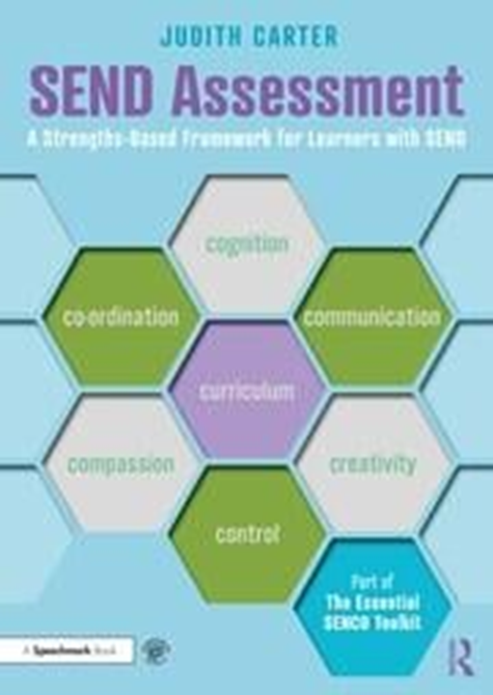
How do we identify children with SEN and ensure they make progress?
We use the Graduated Approach of Assess, Plan, Do, Review to identify potential SEN and then track our pupil’s individual learning needs.
We use various methods of assessment:
INDES ● 7C’s ● ongoing daily formative assessment ● Summative assessment ● Information from families ● Pupil’s own views ● Reports from external professionals ● SENCO monitoring of reasonable adjustments and specific SEN assessments
ALL children’s progress in the core subjects is recorded on pupil asset which enables us to monitor progress and make comparisons with other schools’ whole school and SEND data
Once a child is identified as having SEN we assess every term using the 7C’s approach to help identify pupil strengths and barriers to learning.
(If you click on the book to the right you will find more information)
The 7Cs provides a language of assessment that we can all use. We talk about each skill with the children and together agree strengths and areas for development. This helps us plan next steps and interventions. We are able to monitor the impact of SEN provision as the 7C’s helps us capture small steps of progress.

Slide 8
How do we identify children with SEN and ensure they make progress?
There is not one exact process to identify a learning need as each individual learner is unique. Identification begins with observations and discussions by the class teacher, the parents and the SENDCO. Some of the other methods we use are: in-school diagnostic assessments for reading, maths, phonics, vocabulary, working memory, logic, and self-esteem.
Professionals we have access to include, but are not exclusive to: private speech and language therapist, specialist learning support teachers, educational psychologist, schools and communities team, ASD and SEMH specialists.
At Wells we are committed to ensuring that all learners have access to learning opportunities, and for those who are at risk of not learning, we will intervene. Only those with a learning difficulty that requires special educational provision will be identified as having SEND.

Slide 9
If a child is identified as having SEN we will with their family identify areas of strength and areas for development using the 7c’s language
Teachers use this information to decide upon teaching adjustments, necessary interventions and write a learning support plan which follows the graduated approach of Assess, Plan, Do, Review
All information is shared termly with families either via email/phone or in person dependant on individual preference
How do we identify children with SEN and ensure they make progress?

Slide 10
Education, Health Care Plan (EHCP)
In some cases a child’s needs cannot be met through reasonable adjustments and the core provision given to all. In these circumstances we would work with families to decide upon the best course of action and may request an Education, Health Care needs assessment. We support families throughout the entire process.
If a child already has an EHCP when they come to us, we ensure all staff working with the child are aware of needs and all requirements laid out in the plan. An annual review will be held at the school with the child and family at the forefront to review progress and required provision.
Click here for information on the EHCP process in Norfolk: EHCP Norfolk
Click here for information on support and advice available in Norfolk: Norfolk SENDIASS
Norfolk EHCP Family advice line: 01603 679 183

Slide 11


How do we ensure our teaching and curriculum is inclusive and accessible to all?
Adaptive teaching – high quality teaching ensuring SEN support is delivered in all classrooms.
Extra support for children that need something additional or extra.
SEN support plans in place for all children on our SEN register – they are reviewed termly in conjunction with class teachers and parents
EHCPs are in place where necessary to outline the support a child requires.
External services – eg Speech and language, Educational Psychologists, Social and Emotional support teachers
Educational and Pastoral Assistants employed to support children where necessary
We have two Enhanced SEN Provisions within our school ‘ Ebb and Flow’ our cognition and learning KS2 base and ‘Starfish’ our EYFS/KS1 complex needs base. More intensive and tailored support can be offered within these classes.

Slide 12
Our expertise and training
Our School SENDCO holds the National Professional Qualification for Senco’s
They also attend half-termly network meetings with Wensum Trust colleagues led by Rachel Wilson who is the trust Educational Psychologist.
In addition to all of the above our SENCO also attends many training sessions provided by The Learning and SEND Inclusion team at Norfolk County Council.
Teachers and Educational & Pastoral Leads/Assistants attend regular training sessions around successful provision for SEND pupils
Teachers Educational & Pastoral Leads/Assistants attend external professional development training regularly
2024/5 teacher and EPL/A training thus far: Wise about Words, 7C’s, PEaSS; making reasonable adjustments, Attachment Trauma, Targeted outcomes

Slide 13
How we spend SEND funding
Additional Adult Support
Enhanced SEN Provision:
Ebb & Flow/Starfish
Training
Resources & equipment
Educational Psychologist & specialist teachers
Specialist support, Speech & Language Therapist

Slide 14
Ensuring pupil and family voice is heard
Our school knows the importance of working closely with children and their families in order to achieve the best possible outcomes and support for pupils
Families of children recorded as SEN have termly meetings (face to face or over phone depending on personal preference) with Class Teachers and the SENDCO
Pupils meet with their classroom teacher termly to discuss their thoughts, concerns and progress
All of the above is recorded on a pupils learning support plan
Classroom teachers are always ready to listen to family’s thoughts and can be spoken to at the end of any school day or via Class Dojo

Slide 15
What to do if you have concerns or a complaint
If families are unhappy with any aspect of provision, we strongly encourage you to share this with your child’s class teacher and SENCO in the first instance. We will listen and work with you to try to reach a solution.
In the event you feel your concern has still not been resolved you may wish to speak to the headteacher:
head@burnhammarket.norfolk.sch.uk
Should you wish to make a formal complaint please click on the policy attached

Slide 16




Support services for families of children with SEND
Just one Norfolk website has a wealth of information for families and a friendly voice at the end of the line to direct you to the right help. There are also lots of online learning courses if you are interested.
Click on this icon and take a peek!
Norfolk SEND information and advice support service also offer impartial information and advice
Click here!
Norfolk Community Directory contains activities, services and groups to help all Norfolk residents live healthy, active and fulfilling lives.
Click here to find out more!
SEND Norfolk Local offer also has lots of information for young people with SEND aged 0-25yrs and their families
Click to take a look!

Slide 17



Professional support services we work with
Health – Just One Norfolk, Neuro development service,
speech and language services, occupational therapy
Education – virtual sensory support, educational psychologist,
dyslexia outreach, specialist teachers, inclusion and SEND team
Care – Early help, School and Community Team, Nelsons Journey

Slide 18
How we support school to school transitions
We are very aware that moving on to another school can be very daunting for all children but especially for many with SEND
We will work closely with whichever school you choose for you child when they move on from Y6. This usually starts around Easter but again is dependant on individual need
We tailor our transition strategy to best fit the needs of the individual child. This may include extra visits to the new school for familiarisation and orientation
We do lots of work in school to prepare children for their next steps and always ensure the next school has all of the detailed information they need in order to continue to support your child
We also always listen to families ideas as to how to make this transition as smooth as possible for their child
For children who are new to us, we work closely with their previous school to ensure we have all the information we need to support the child. We offer as many orientation/familiarisation visits as the family would like. This could be led by a peer/peers, or member of staff. We also offer new children with SEND a staggered integration timetable if this is appropriate and supported by their family
Due to the fact that our transition strategy is bespoke, it is under constant review

Slide 19
Policies
Admissions policy
Attendance Policy
Behaviour and regulation Policy
Complaints Policy
Equality Policy
Medical conditions Policy
Safeguarding Policy
SEND Policy

Slide 20
Key Adults regarding SEND
Class Teachers
SENDCO: Mrs Emma Beck
Headteacher: Mrs Rachel Stroulger
SEND Governor: Mrs Kelly Cawston
Chair of Governors: Mr Sam Dack

Slide 21







Classes of Wells-next-the-sea Primary & Nursery School
2025

