Slide 1




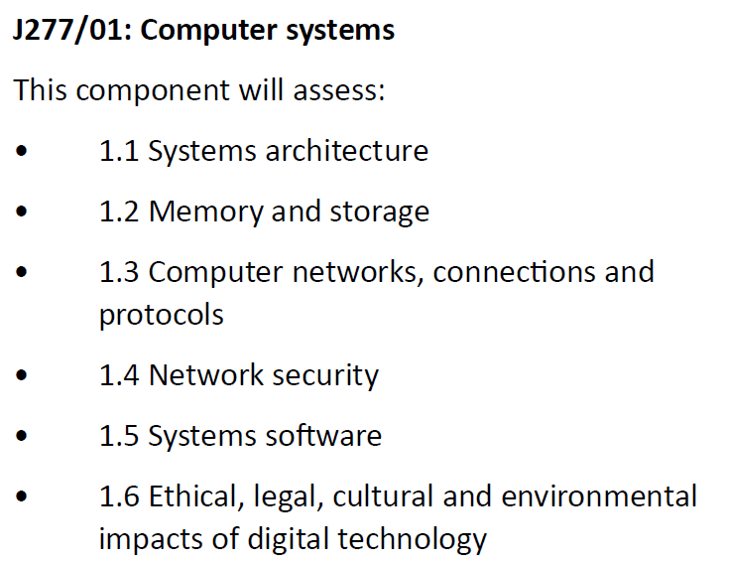
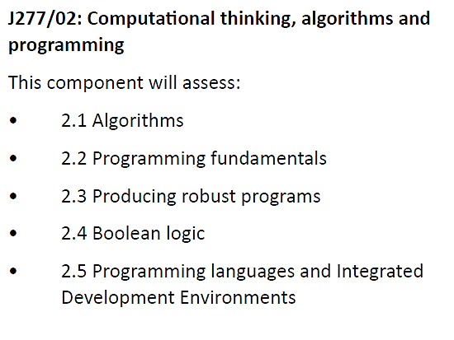
Paper 1 50%
Paper 2 50%
Both papers will be sat at the end of Year 11
Paper 1 exam time:
1 hour 30 minutes
Paper 2 exam time:
1 hour 30 minutes

Slide 2
Year 11 Computer Science – Supporting your Child’s Progress
Make achievement everyone’s responsibility by…
Talking about learning regularly
Create a distraction free ‘zone’ for your child to practice programming
20 minutes of coding at home per week
We ask that all Computer Scientist practice programming, at home, for at least 20 minutes each week.
Not sure where to begin?
  Google: “online Python” or “Python Tutorial” and your child will have all they need, from beginner to expert.
Computers are everywhere!
Encourage your child to look for computers as they go about their day to day lives e.g. computers the come across inside, computers they come across outside.
Ask how these computers work. Brilliant questions that can be used anywhere are:
  what are the inputs and what are the outputs?
  what is the computer doing?
  is the computer part of a network and if it is, how is it connected?

