Slide 1



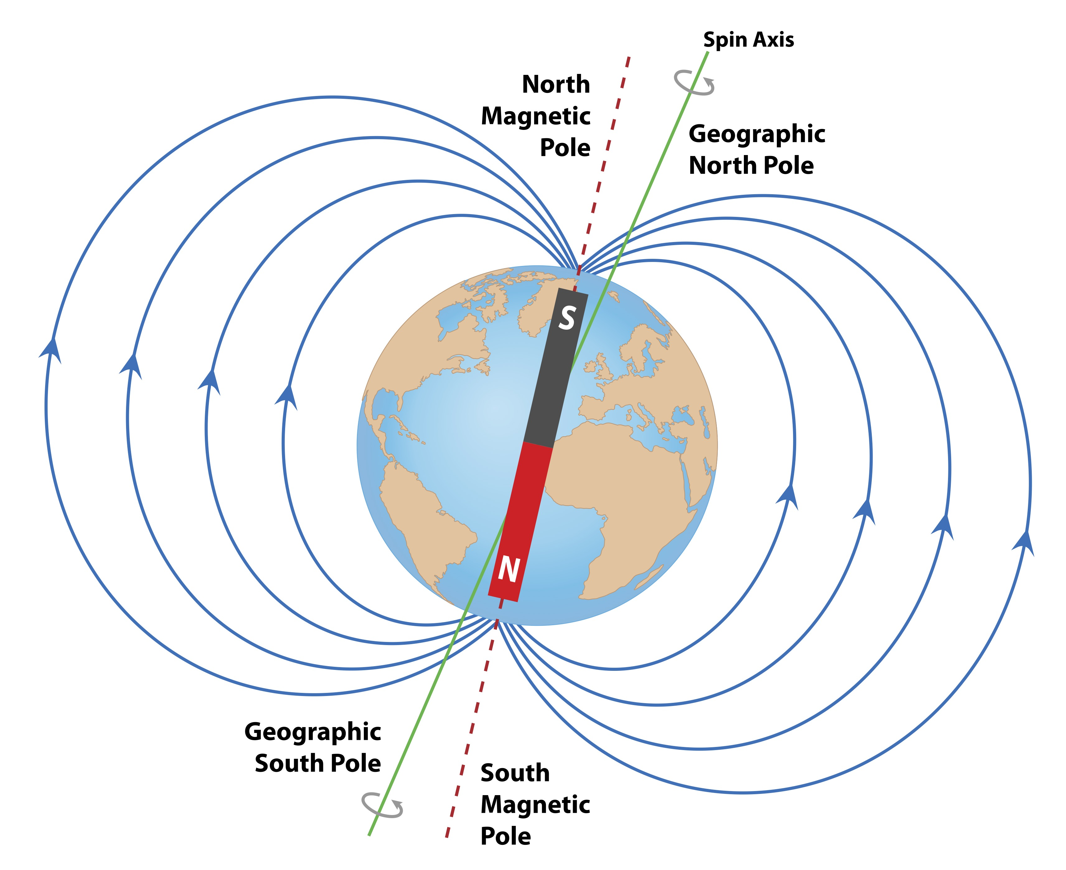

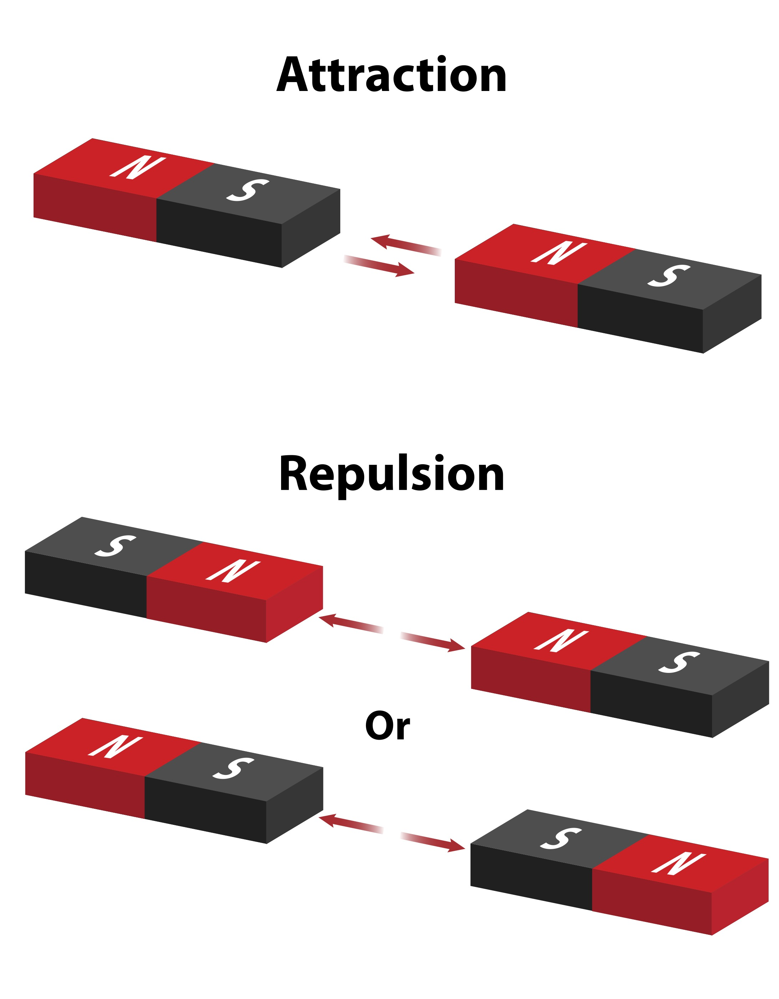
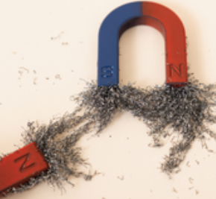

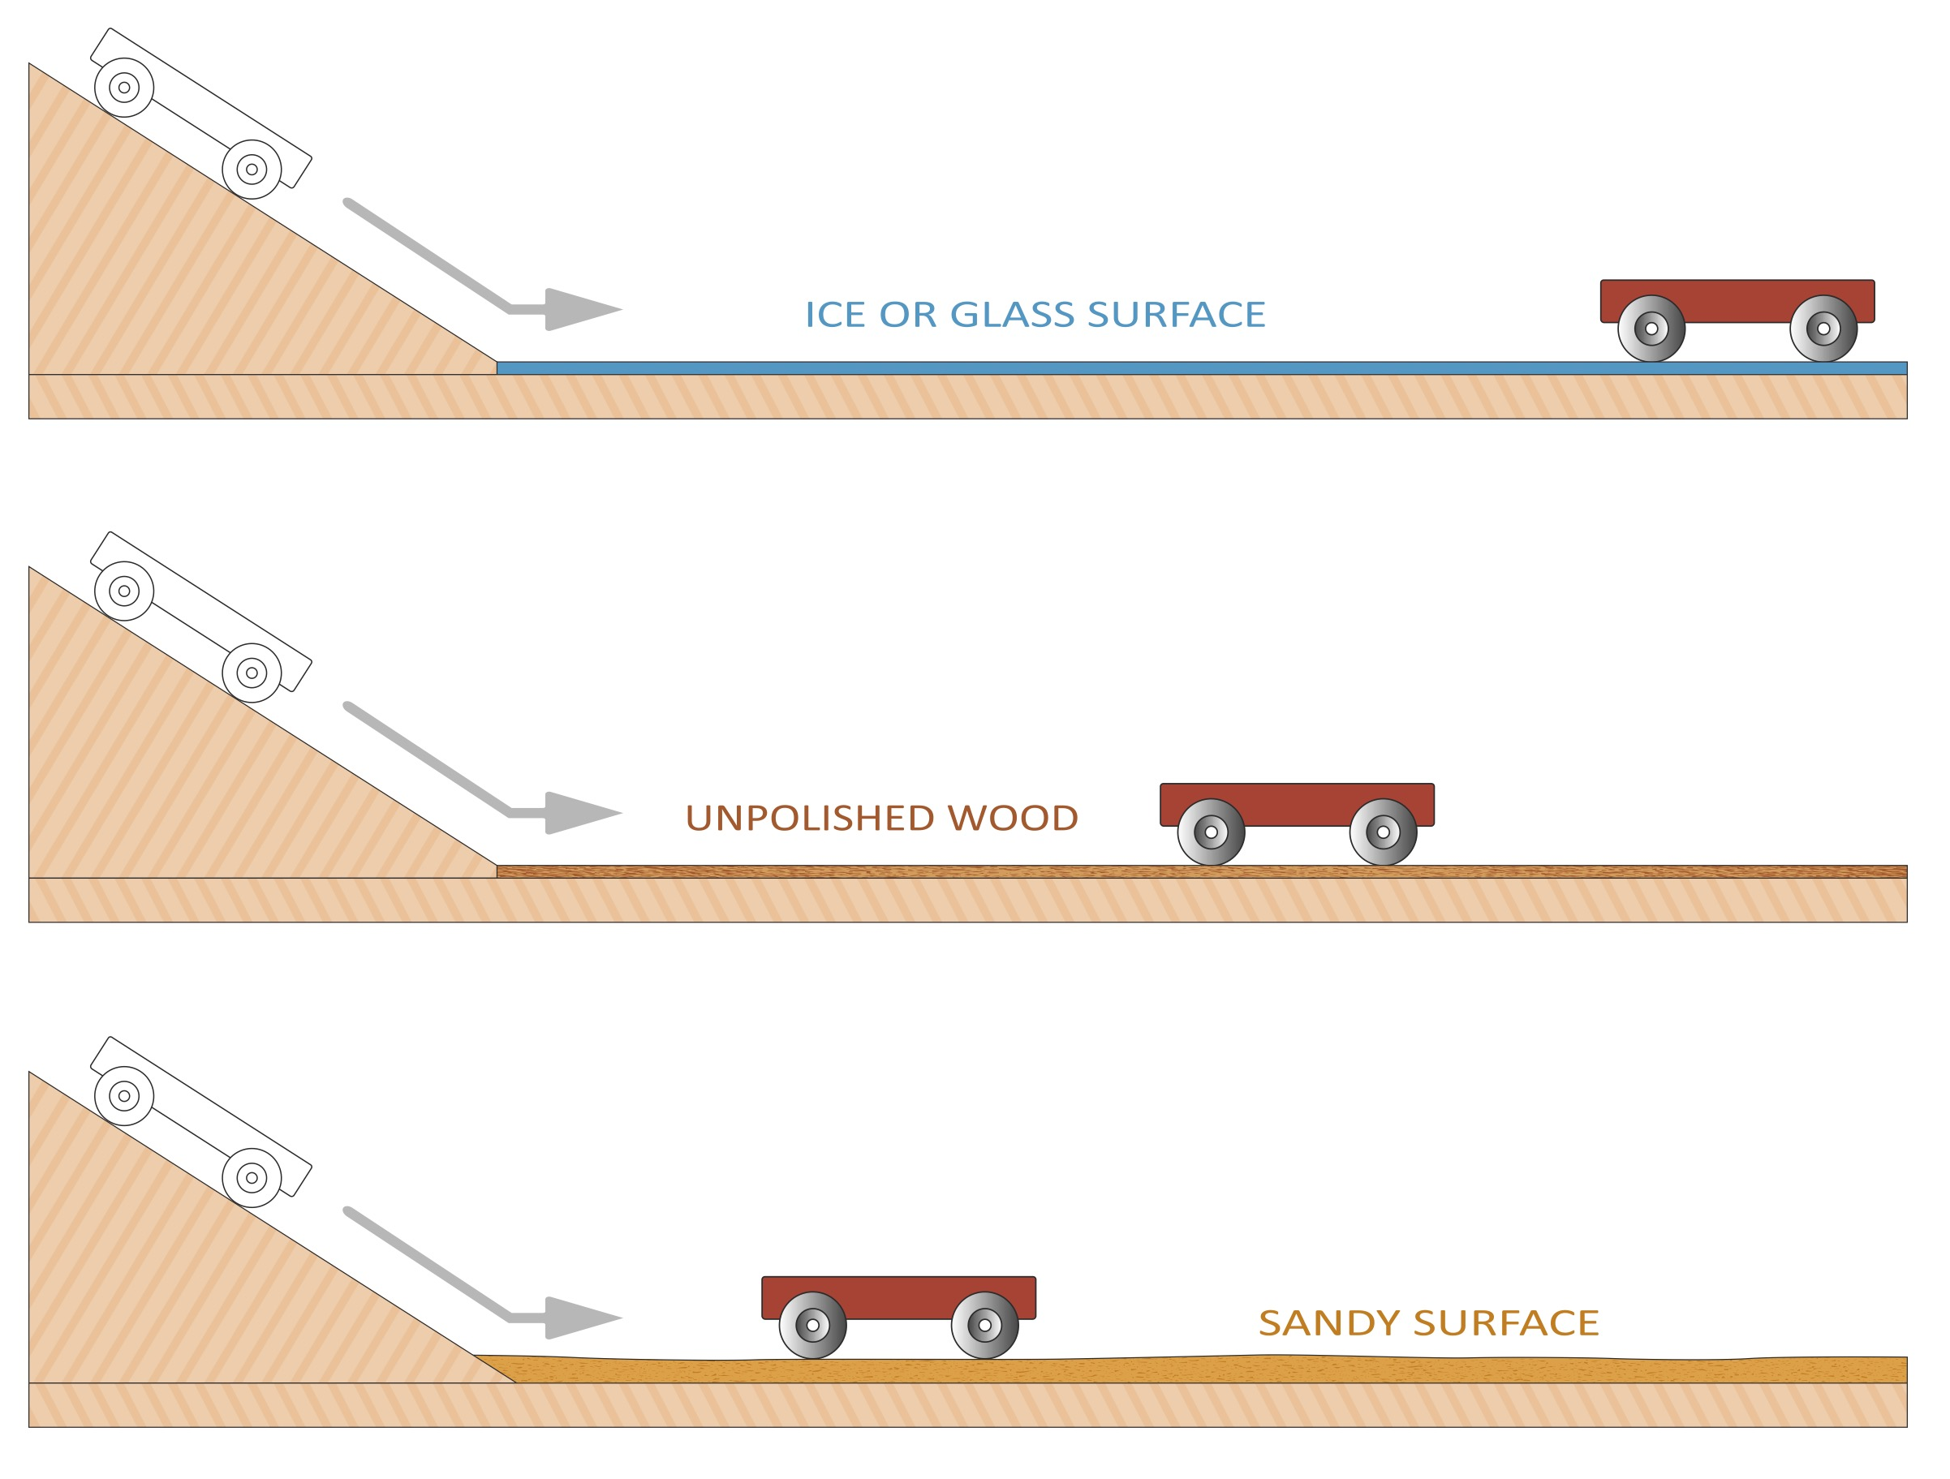
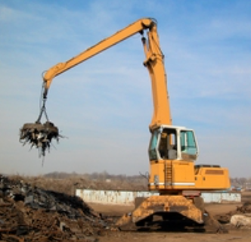
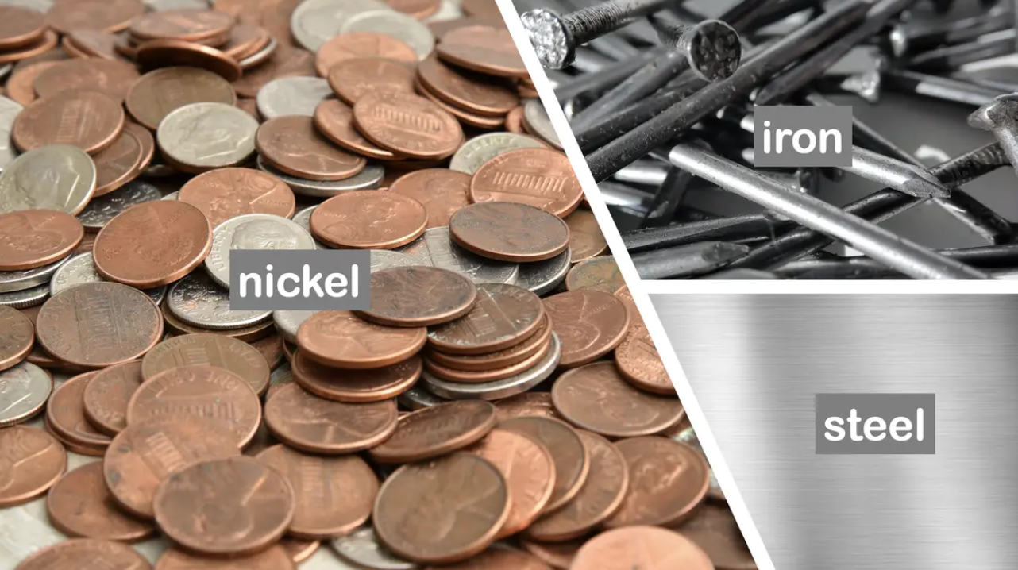

Year 3: Forces and Magnets
Knowledge Organiser
Careers connected to this unit: mechanical engineer, maglev engineer, train driver, product designer
Lesson Sequence
Forces
Magnetism
Forces are pushes and pulls
Forces cause things to move, or to stop moving
Forces can be contact (friction) or non-contact (gravity, magnetism)
Magnets are made of metal or rock
They have a magnetic field around them which attracts magnetic materials, pulling them towards the magnet
All magnets have two poles: north and south
The Earth also has a magnetic field
1. Explore contact and non-contact forces
2. Investigate how things move on different surfaces
Magnetic Forces
Friction
3. Explore different types of magnets
When an object moves across a surface, friction acts as an opposite force. Friction is a force that holds back the motion of an object.
Some surfaces create more friction than others, meaning that objects move across them more slowly.
The rougher the surface, the more friction it creates.
4. Explore everyday objects that are magnetic
ice or glass surface
5. Understand that magnetic forces can act at a distance
Magnetic Metals
wooden surface
6. Explore the everyday uses of magnets
carpet surface
Developing Experts Copyright 2025 All Rights Reserved

Slide 2

Year 3: Forces and Magnets
Knowledge Organiser
Careers connected to this unit: mechanical engineer, maglev engineer, train driver, product designer
Rocket Words
force | a power or strength that can cause an object to move
motion | the process of movement
friction | a force that slows down or stops objects when two surfaces rub against each other
magnet | an object that can attract or repel some metal items
attract | to pull towards
repel | to force back or push away
magnetic field | the area around a magnet where its magnetic force can be felt, even without touching it
magnetic poles | the two ends of a magnet where its magnetic force is strongest
Developing Experts Copyright 2025 All Rights Reserved

